Slide 1
Machine Learning Foundations: Day 8

Slide 2
Part 1
Notes:
Loss Functions as a Measure of Error: In supervised learning, we need a way to measure how well our model is performing so that we can improve it. This is what a loss function (or cost function) provides – it quantifies the difference between the model’s predictions and the true targets. A higher loss means the model’s predictions are far off, and a lower loss means they’re more accurate. For example, if our model’s predictions are completely wrong for a given sample, it will incur a high loss, whereas if it predicts correctly, the loss will be low . In essence, the learning process is about adjusting the model to minimize this loss over the training data. Different tasks use different loss functions. For classification problems, a common choice is cross-entropy loss (also known as log loss), whereas for regression problems (predicting continuous values), we often use mean squared error (MSE) loss.

Slide 3
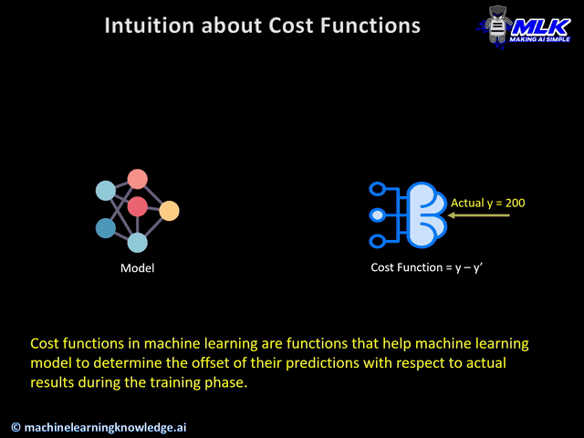
Reminder on CFs
Notes:
A cost function in machine learning quantifies how far off a model’s prediction is from the actual value. The diagram illustrates a neural network (left) making a prediction, then asking the cost function (right) to measure how accurate it was. The cost function calculates the difference (error) between the prediction y’ and the true value y. For instance, if a model predicts house prices and guesses €180,000 when the actual price is €200,000, the cost function identifies a €20,000 error, signaling the model to adjust its parameters and reduce errors in future predictions.
During the training phase, the model assumes the initial weights randomly and tries to make a prediction on training data. But how will the model get to know how much “far” it was from the prediction? It definitely needs this information so that it can adjust the weight accordingly (using gradient descent) in the next iteration on training data.
This is where cost function comes into the picture. Cost function is a function that takes both predicted outputs by the model and actual outputs and calculates how much wrong the model was in its prediction.
Now with this quantifiable information from cost function, the model tries to adjust it’s weight for the next iteration on training data so that the error given by cost function gets further reduced. The goal of the training phase is to come up with weights that minimize this error in each iteration to the point where it can’t be reduced further. This is essentially an optimization problem.
This animated illustration explains the concept of a cost function clearly. A neural network model (left) makes a prediction (here, predicting 50), and sends it to the cost function (right). The cost function then measures how accurate this prediction was by comparing it to the actual value (200 in this example), calculating the difference or error (150 here). The model receives this feedback, adjusts its internal parameters, and attempts again in subsequent epochs. Over multiple iterations (epochs), the cost function continuously evaluates predictions, helping the model learn by reducing this error. Essentially, the cost function acts like a teacher correcting a student, providing feedback on errors so the model improves and eventually achieves accurate predictions.

Slide 4
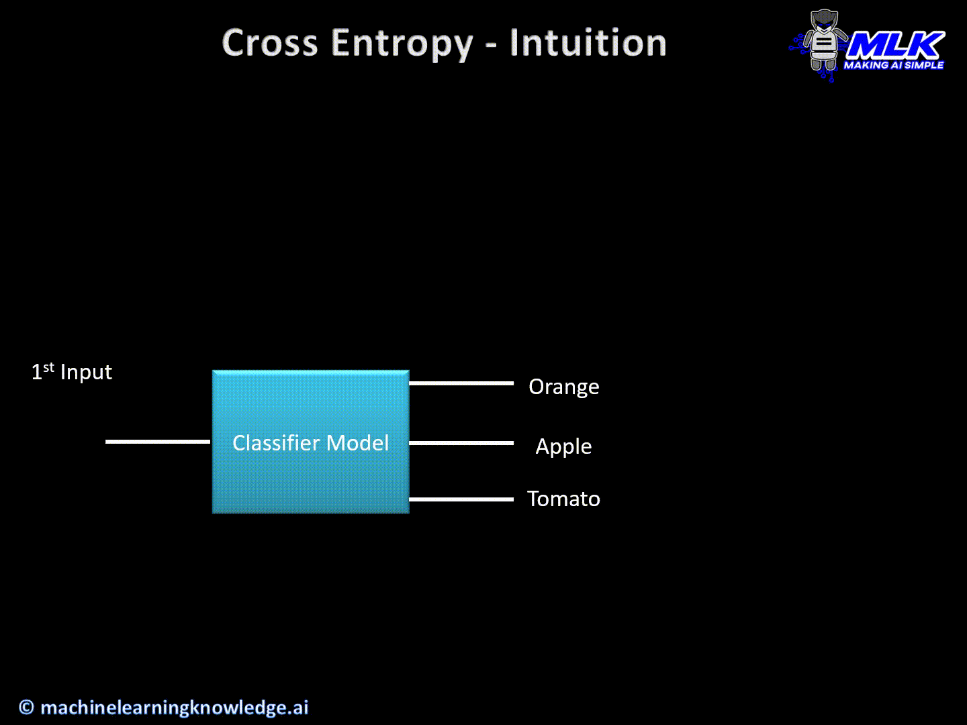
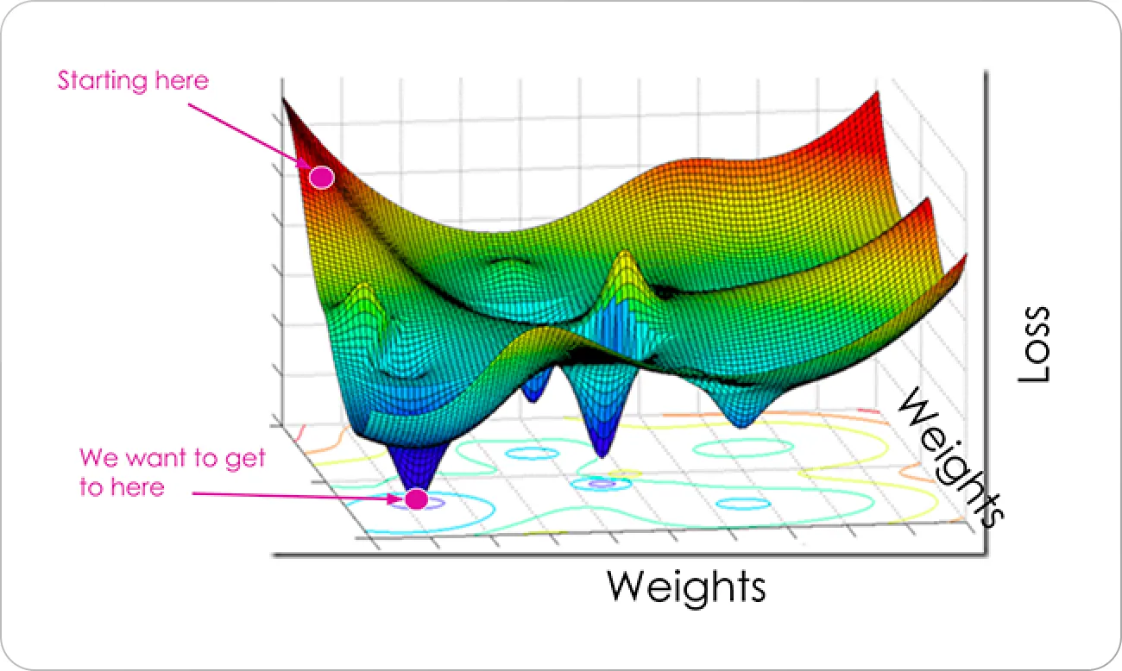
Cross Entropy Loss
Notes:
Now that we have learned how to perform one-hot encoding in PyTorch, we can pass this, along with our output predictions yhat, to a loss function. yhat is stored as the tensor "scores". Meet our first loss function: cross-entropy loss. This is the most used loss function for classification problems. PyTorch provides the handy CrossEntropyLoss() function shown. We start by defining our loss function as "criterion". We then pass it the .double() method of the scores tensor and the one_hot_target tensor. This casts the tensors to a specific float data type that is accepted by the CrossEntropyLoss() function. The output shown is the loss value.

Slide 5
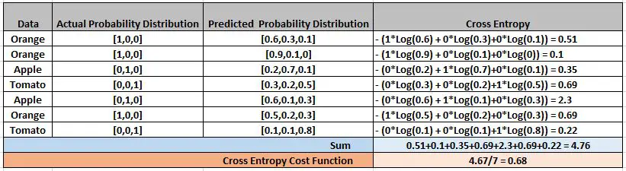
Cross Entropy Loss
Notes:
Why Minimizing Loss Matters: The goal of training a neural network is to find the model parameters (weights and biases of all neurons) that minimize the loss function on the training data. Intuitively, if the loss is high, it means the model is making bad predictions, and if the loss is low, it means the model is predicting well . So, we want to push the model toward that low-loss, high-accuracy regime. But how do we actually adjust the model to reduce the loss? This is where calculus and derivatives come into play. A derivative tells us the rate of change of the loss with respect to a given parameter – essentially, it answers: if I nudge this weight a little up or down, how will it affect the loss? If the derivative is positive, increasing the weight increases the loss (so we should probably decrease the weight to reduce loss). If the derivative is negative, increasing the weight decreases the loss (meaning we might want to increase the weight). If the derivative is zero, we are at a turning point (which could be a minimum, maximum, or saddle point). In training, we seek a minimum of the loss function – ideally the global minimum (the lowest possible loss), though for complex deep networks the loss surface is usually non-convex (with many hills and valleys), so we often settle for a good local minimum.

Slide 6
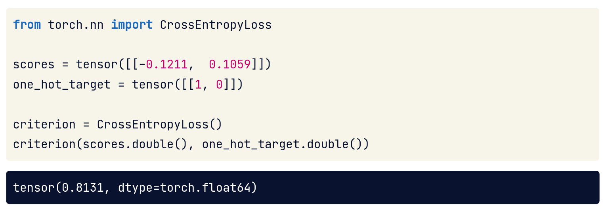
Cross Entropy Loss In PyTorch
Notes:
Cross-Entropy Loss: Cross-entropy is a loss function that is particularly suited for classification models that output probabilities (often via a softmax or sigmoid function). It measures the dissimilarity between the predicted probability distribution and the true distribution (the true labels). The cross-entropy loss increases as the predicted probability of the correct class decreases . In other words, if the model is very confident in a wrong answer, the penalty is large. For example, predicting a probability of 0.01 (1%) for the true class when it should be 1 (100%) will result in a very high loss . Conversely, a perfect prediction – assigning probability 1 to the correct class – would yield a loss of 0 (since there’s no error to speak of). This makes intuitive sense: we want our model to assign high probability to the correct answers, and cross-entropy heavily penalizes cases where it doesn’t. Mathematically, for binary classification, cross-entropy can be expressed as -[y\log(p) + (1-y)\log(1-p)], and for multi-class classification it generalizes to -\sum_{c} y_{c}\log(p_{c}) (where y_c is 1 for the true class and 0 for others) . The key takeaway is that cross-entropy is differentiable and guides the model to improve its probability estimates – it’s zero when predictions are perfect and grows as they diverge from reality. In practice, frameworks like PyTorch provide this loss ready-made. For instance, one can use torch.nn.CrossEntropyLoss to compute the loss between the model’s output scores and the true labels. A quick example: suppose our model produces a score vector for two classes and the true class is the first one. We can define criterion = CrossEntropyLoss(), and if the model’s output scores and the one-hot target label are given, criterion(output_scores, target) will output a single scalar loss value. In the slides, a simple PyTorch snippet shows exactly this: using CrossEntropyLoss on a pair of scores (e.g., [-0.1211, 0.1059]) with a one-hot target [1, 0] yields a loss of about 0.8131 . This number reflects the model’s error for that example – the output wasn’t extremely confident, but it leaned toward the wrong class enough to incur that loss. Cross-entropy is widely used because it aligns well with maximizing accuracy: minimizing cross-entropy is equivalent to maximizing the likelihood of the correct classes.
On this slide, we introduce Cross Entropy Loss and how to use it in PyTorch. Cross entropy is a very common loss function for classification tasks – it measures the difference between two probability distributions: one is the model’s predicted probabilities for each class, and the other is the true distribution (which is usually “one-hot” – meaning all probability mass on the correct class). If those two distributions match perfectly (the model is certain and correct), the cross entropy loss is low. If they differ a lot (for example, the model was confident but wrong), the loss is high.
In the code snippet shown, we see how to use PyTorch’s CrossEntropyLoss. We first import it (from torch.nn import CrossEntropyLoss). Then we have some example model output scores (logits) and a one-hot encoded target for the true class. We create a CrossEntropyLoss object called criterion. Finally, by calling criterion(scores, target), PyTorch computes the cross entropy loss between the model’s predicted scores and the actual target. The output we see (e.g., a tensor with value ~0.8131) is the loss value.
What’s happening behind the scenes is PyTorch is applying the cross entropy formula: it likely applies a softmax to the scores to turn them into probabilities and then calculates the negative log likelihood of the correct class. The key point for us is: CrossEntropyLoss simplifies our work – we don’t have to manually code the formula; we just pass in the model’s outputs and the true labels, and it gives us a loss value. This loss is what we will try to minimize during training.
In practice, if you’re classifying, say, images of cats vs dogs, cross entropy loss will be low if the model assigns high probability to the correct label (e.g. 90% “cat” for an actual cat image) and high if it’s confidently wrong (e.g. 90% “dog” for an image that is actually a cat). Cross entropy effectively punishes confident wrong predictions a lot, which makes our model learn to avoid those. Keep this PyTorch usage in mind – we’ll use criterion = CrossEntropyLoss() in training classification models to measure error.

Slide 7
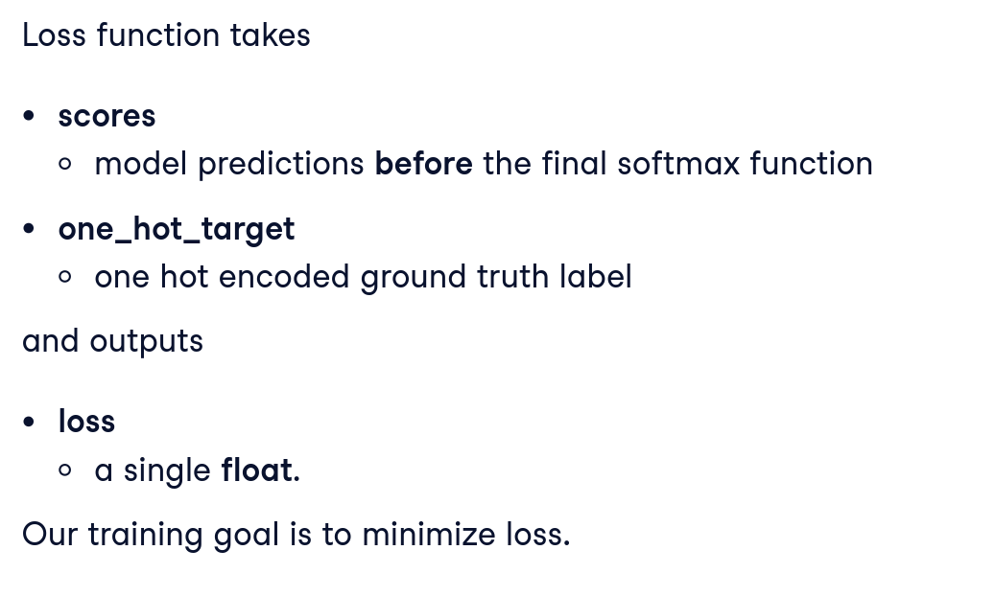
Bringing It All Together
Notes:
Mean Squared Error (MSE) Loss: For regression tasks, where the goal is to predict a continuous value (like a salary or a price), we typically use mean squared error. MSE is the average of the squares of the differences between predicted values and actual values . For example, if the true salary is $100k and the model predicts $90k, the squared error for that instance is $(100 - 90)^2 = 100$. We average such squared errors over all training examples to get the MSE. Formally, \text{MSE} = \frac{1}{m}\sum_{i=1}^{m} (\hat{y}^{(i)} - y^{(i)})^2, where $\hat{y}^{(i)}$ is the prediction and $y^{(i)}$ the true value . Squaring emphasizes larger errors (so big mistakes are penalized more than small mistakes), and the averaging makes it an overall measure of model performance on the dataset. Like cross-entropy, MSE is differentiable, which means we can compute gradients from it. Minimizing MSE corresponds to making predictions as close as possible to the actual values. If the model predicts perfectly for all training examples, the MSE would be 0 (no error). In PyTorch, you might use torch.nn.MSELoss or simply compute (predictions - targets).pow(2).mean() as the loss. MSE loss results in a nice convex shape for simple linear models, which helps optimization (more on convexity soon), but it may not be appropriate for probabilities or classification tasks – that’s why we don’t use MSE for classification, and instead prefer cross-entropy in those cases.
This slide is titled “Bringing It All Together,” and it’s about connecting the dots between the concepts we’ve learned: model outputs, loss calculation, and how it ties into the training loop. Up to now, we’ve discussed things somewhat in isolation – e.g. what a loss function is, what derivatives are – but now we want to see the whole picture of training a neural network step by step.
Imagine we have a simple neural network making a prediction. “Bringing it all together” means we take the model’s output, compare it with the true label using a loss function (like cross entropy or another appropriate loss), and then use that loss to improve the model. This slide likely depicts either a flowchart or code snippet illustrating the full forward-and-backward process:
1. Forward pass: Input data goes through the model to produce an output (predictions).
2. Loss computation: The output is compared to the ground truth using a loss function (for example, using the CrossEntropyLoss we just saw). We get a single number representing how bad the prediction was.
3. Backward pass (backpropagation): Using the loss, we compute gradients (derivatives) of the loss with respect to each model parameter. This tells us how each weight contributed to the error.
4. Parameter update: We then adjust the model’s weights slightly in the direction that reduces the loss (typically moving weights opposite to the gradient direction).
All these steps together form one iteration of training. This slide emphasizes that these pieces are not isolated tricks but parts of one continuous pipeline: input -> model -> loss -> compute gradient -> update model. When you implement training code, these happen in just a few lines: you do output = model(data), then loss = criterion(output, target), then loss.backward() to compute gradients, and then an optimizer step (e.g. optimizer.step()) to update weights.
The phrase “bringing it all together” is reinforcing the idea that training a model is an end-to-end process. We start from data, end with updated parameters, and each piece (forward pass, loss, backward pass) links to the next. After this slide, we’ll zoom in on some of these pieces (like derivatives and backprop) to ensure you understand them deeply, but keep this full picture in mind: it’s how everything works in unison to train a neural network.

Slide 8
Derivatives: Minimizing Loss
High loss: model prediction is wrong
Low loss: model prediction is correct
Notes:
Derivatives and the Slope Analogy: A common analogy is to imagine the loss function as a landscape or curve, where the height of the land is the loss value and the position (horizontal axes) represents the model parameters. Training the model is like trying to get to the lowest valley in this landscape – that’s where the loss is minimal and the model is performing best. Derivatives (in higher dimensions, gradients) are like the slope of the ground under our feet. If we stand at some point on this loss landscape (i.e. at the current parameter values), the derivative tells us which direction is downhill. A positive derivative means we’re on an uphill slope in that direction (loss would increase if we move that way), and a negative derivative means we’re facing downhill (loss decreases in that direction). Just as a hiker can feel the slope of a hill to decide which way to walk to go downward, our training algorithm uses derivatives to decide how to change the weights to go “downhill” on the loss curve . In fact, one can imagine being a blindfolded hiker on a complex hill: you don’t know exactly where the lowest point is, but if you continuously take steps in the direction of steepest descent (the negative gradient direction), you will move towards lower ground . That’s exactly the idea behind gradient descent, which we’ll formalize shortly.
Here we focus on derivatives (or gradients) and their role in minimizing loss. The slide notes that:
• High loss means the model’s prediction is wrong (far from the true value).
• Low loss means the model’s prediction is correct (close to the true value).
These bullet points highlight why we care about loss: it’s a measure of error. If the model is doing a bad job, the loss will be a high number; if it’s doing well, loss is low. Our ultimate goal in training is to reduce the loss, which corresponds to improving the model’s accuracy or performance.
Now, how do derivatives come into play? A derivative in this context is essentially the slope of the loss function with respect to a model parameter. Think of the loss as a landscape or curve, and the model’s current settings (weights) as a point on that landscape. A derivative tells us the direction and steepness of the slope at that point. If the slope is positive (rising), increasing that weight will increase the loss – meaning we’re going the wrong way – so we should decrease the weight to go downhill (lower the loss). If the slope is negative (falling), increasing that weight would decrease the loss (good), so we should increase that weight slightly.
A simple analogy: imagine you’re hiking on a hill in fog, trying to reach the lowest point in the valley (the minimum loss). If you can feel the slope of the ground with your feet (that’s like computing the derivative), you can tell which direction goes downhill. If it’s steep under your feet, that’s a large gradient – you should take a bigger step in that direction. If it’s almost flat, you’re likely near a minimum and you take very small steps. This is exactly what derivatives let us do with our model’s loss: they guide the adjustments to weights to go “downhill” on the loss landscape.
In summary, derivatives are the mathematical tool that let us minimize the loss. They translate the abstract goal of “make the loss smaller” into a precise direction and magnitude for changing each parameter. Without derivatives, our model would have no clue how to tweak its parameters to improve – it would be like guessing blindly. With derivatives (and algorithms like gradient descent), we have a systematic way to improve the model gradually, which is what learning is all about.

Slide 9
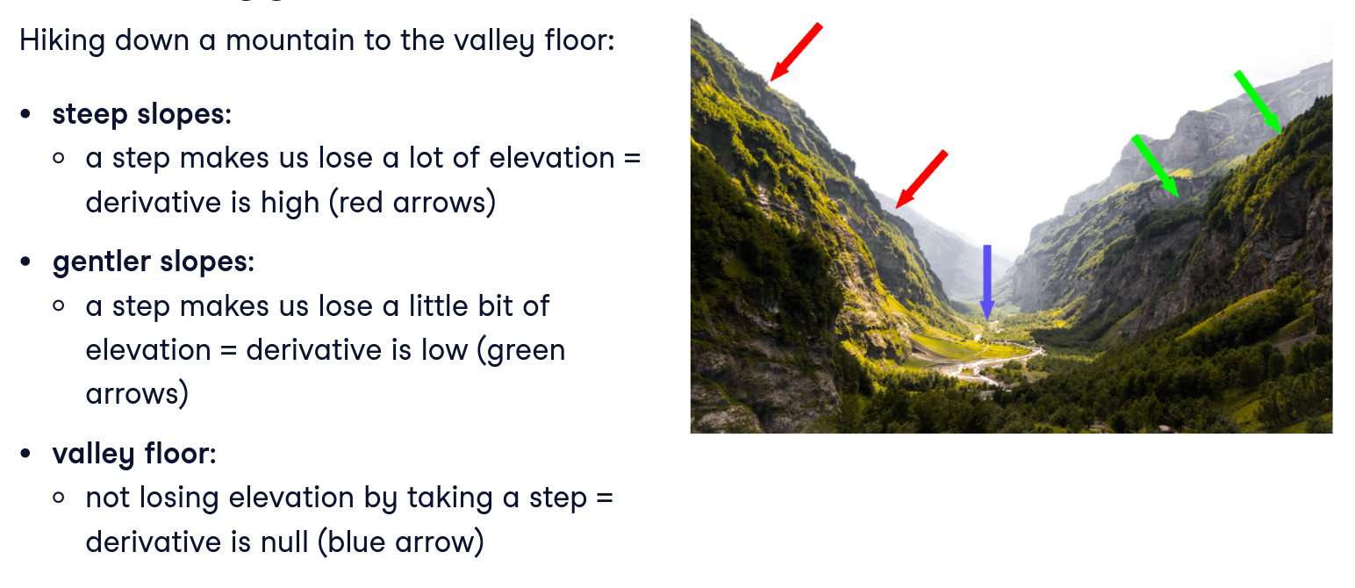
Analogy For Derivatives
Notes:
Let's think of the loss function we are trying to minimize as a valley. Each horizontal step (along x) involves gaining or losing some height (y). At steeper slopes, a single step means losing or gaining a lot of elevation. Mathematically, the derivative (or slope) is high. Inversely, at gentler slopes, a single step involves losing or gaining less elevation, meaning a smaller derivative, or slope. Finally, the bottom of the valley is flat, and elevation does not change at each step: the derivative is null. If the valley is our loss function, the function is at minimum when the derivative is null.
To make the concept of derivatives and gradient-based optimization more intuitive, this slide provides an analogy. A common analogy for derivatives in machine learning is the mountain or hill analogy we just used, so let’s elaborate on that, as it’s likely similar to what the slide conveys:
Imagine you are standing on a hillside in the dark or fog and you want to get to the lowest point in the valley. You can’t see the whole landscape, but you can feel the slope of the ground where you stand. If the ground slopes downward in a certain direction, you take a step that way. The steeper the slope, the bigger step you can take (because you know you’re going downhill confidently). If the ground is flat or only slightly sloped, you take a cautious small step because you might be near a valley bottom or a ridge. This process of feeling the slope and stepping downhill is analogous to how we use gradients to update our model parameters.
The derivative (gradient) at your current position corresponds to the slope of the loss function given the current model parameters:
• A large gradient means a steep slope – we’re far from optimum and know which direction will reduce loss fastest, so we can make a larger update to our parameters.
• A small gradient means the slope is shallow – we might be close to a minimum, so we make smaller adjustments to avoid overshooting or oscillating.
Another everyday analogy: think of tuning a radio or adjusting shower temperature. If you’re far from the right station or comfortable temperature (loss is high), you’ll turn the knob more (bigger adjustment). As you get closer to the desired point (loss decreasing), you make finer adjustments to dial it in. The sensitivity – how much change in output you get per small turn – is akin to the derivative.
The key point of the analogy is that derivatives give us a sense of direction and how much to change. It takes a mathematical concept and makes it visual or experiential. So when you think “derivative,” picture that hillside or the radio knob: it’s telling the neural network which way is downhill (toward lower error) and how steep the path is. This is the core idea behind algorithms like gradient descent, which we’ll formally discuss soon. Keep this analogy in mind; it makes the math less abstract and helps you understand why we compute derivatives at all – it’s so the model can navigate the landscape of loss and find a better spot (lower error).

Slide 10
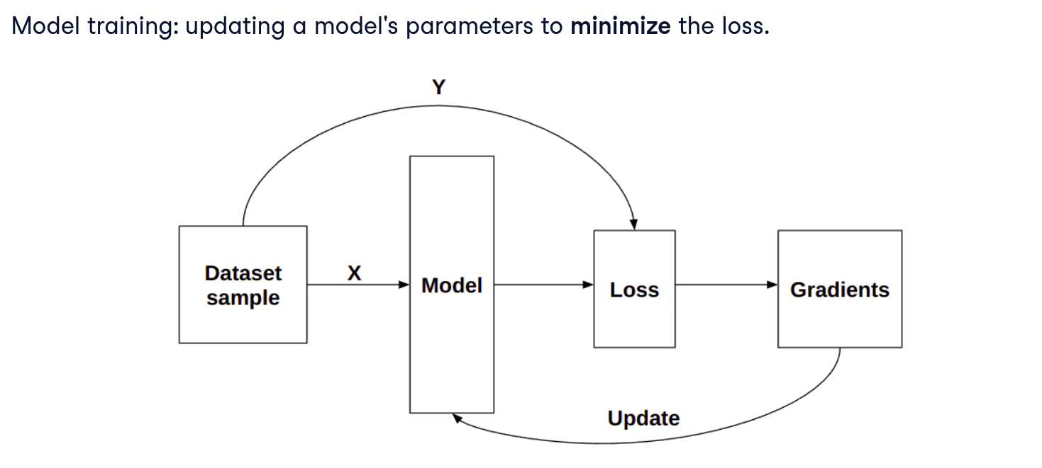
Connecting Derivatives and Model Training
Notes:
In deep learning, we often use the term "gradient" for derivatives. So how do gradients help minimize loss, tune layer weights and biases, and improve model predictions during training? Recall that when a model is created, layer weights and biases are randomly initialized. Training looks as shown: we take a dataset with features X, and ground truth y. We run a forward pass using X and calculate loss by comparing model output, yhat, with y. We compute gradients of the loss function and use them to update the model parameters with backpropagation so that weights are no longer random and biases are useful. We repeat until the layers are tuned.
Now let’s connect those derivative concepts directly to model training. In a neural network, we have many parameters (weights and biases). Each parameter influences the loss in some way. When we compute the derivative of the loss with respect to a particular weight, we get a number (the gradient) that tells us if and how changing that weight would change the loss:
• If the gradient is positive for a weight, increasing that weight increases the loss (not what we want), so to reduce loss we should decrease that weight.
• If the gradient is negative, increasing that weight would decrease the loss (good), implying the weight is currently too low, so we should increase that weight.
• The magnitude of the gradient tells us how sensitive the loss is to that weight. A larger magnitude means a small change in the weight causes a big change in loss – so that weight is “important” to adjust carefully (perhaps with a bigger step if we’re far off, or a smaller step if we’re near optimal).
In model training, we use these gradients for each weight to update the weights in the correct direction. This slide likely outlines that process:
1. Calculate the loss for the current model predictions (as we did with cross entropy or another loss function).
2. Compute gradients of the loss with respect to each parameter (this is done via backpropagation, coming up next).
3. Update parameters in the opposite direction of their gradients.
So the connection is: derivatives (gradients) are the bridge between evaluating the model (getting a loss) and improving the model (tweaking the weights). Without gradients, we would know how bad the model’s error is (from the loss) but not how to make it better. With gradients, each weight gets a little “nudge” in the right direction.
Think of it like giving feedback to a student on an exam: the loss is like the total points they missed (their overall error). The gradient is like specific feedback on each question telling them which mistakes contributed most to that lost points and how to fix them. Then the student can go and focus on those areas to improve. Similarly, gradients tell the model which connections (weights) were most responsible for errors so it can adjust them accordingly.
By iteratively doing this – compute loss, get gradients, update weights – the model’s performance should improve over time (the loss goes down gradually). This is essentially how training works at each step.
To sum up: model training = using derivatives to guide weight updates. Derivatives connect the outcome (loss) back to the components (weights) that produced that outcome, allowing the model to learn from its mistakes. Next, we’ll see how we actually calculate these gradients efficiently using backpropagation.

Slide 11
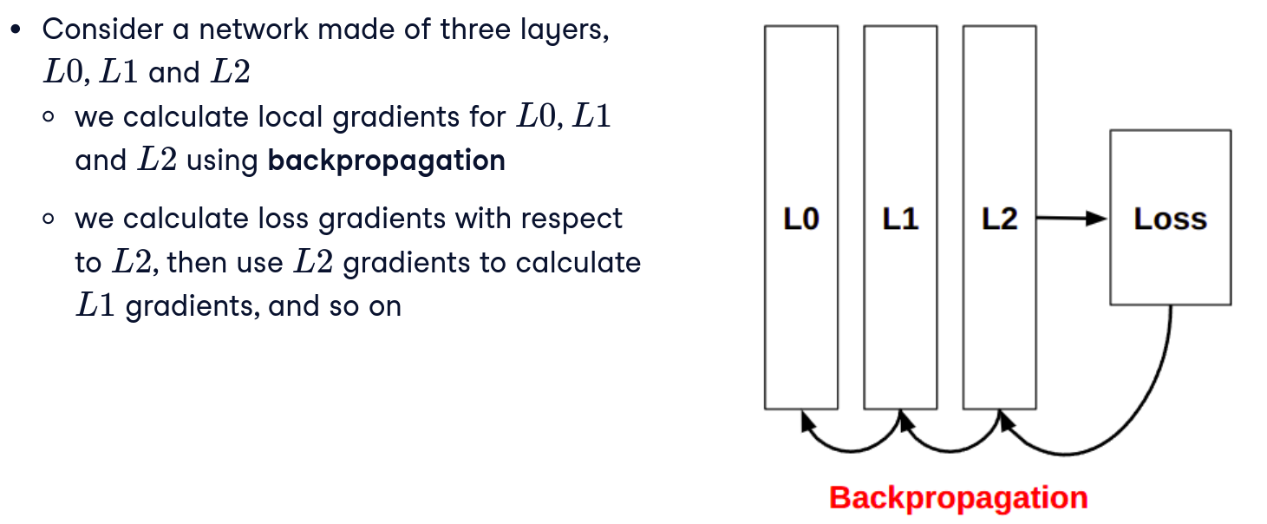
Backpropagation Concepts
Notes:
Backpropagation – Computing Gradients in a Multi-Layer Network: For a simple model (like linear regression), we can derive an explicit formula for the gradient. But for a neural network with many layers of weights, manually computing how each weight influences the final loss is much more complex. This is where backpropagation comes in. Backpropagation (short for “backward propagation of errors”) is an algorithm that efficiently computes the gradients of the loss with respect to all the weights in the network by propagating the error backward from the output layer to earlier layers. It leverages the chain rule from calculus: the idea that the derivative of a composed function can be computed by multiplying derivatives of the inner functions. In a neural network, the output is a function of the last layer’s weights, which are a function of the second-to-last layer’s weights, and so on. Backprop essentially traverses this chain in reverse, starting from the loss at the output and working backward to assign credit or blame to each weight for the observed error.
To clarify, backprop doesn’t magically know which way to change the weights – it calculates it. Each weight multiplies some input value and contributes to the output; backprop finds the derivative $\partial \text{Loss} / \partial \text{weight}$ for each weight, essentially telling us “if you increase this weight by a tiny amount (all else fixed), the loss will increase (or decrease) by this amount.” With that information, we can then actually update the weights in a way that reduces the loss.
Now we come to backpropagation, a fundamental concept in training neural networks. “Backpropagation” (short for backward propagation of errors) is the algorithm that efficiently computes all those gradients we’ve been talking about, especially in a multi-layer (deep) network.
Key ideas likely presented on this slide:
• Backpropagation uses the chain rule from calculus to break down the computation of the loss’s derivative layer by layer. Each neuron’s output affects the next layer and ultimately the loss, so we can propagate the “error signal” backward from the output layer to each preceding layer.
• It’s called “backward” because we start from the output (where we can directly measure error – the difference between prediction and truth) and then move backwards through the network, figuring out how each weight and neuron contributed to that error.
• Conceptually, think of it as apportioning blame (or credit) for the loss to every weight in the network. If the output was wrong, backprop asks: which hidden neurons were most responsible for that error, and by how much? Then, for each of those hidden neurons, which weights going into them caused them to be off? And it continues back to the input. By the end, every weight has an assigned “blame” (the gradient) for the output error.
An easy way to imagine backpropagation is as a series of dominoes or an assembly line in reverse: the forward pass is like going through each station to produce an output. If the final product has a flaw (error), you trace backwards through the assembly line to find where things went wrong and how much each station contributed to the flaw. At each step backward, you calculate how much adjusting that step would have fixed the final error. That information is the gradient for that step (layer). Backprop does this systematically for all layers.
Important points:
• Backprop requires that all the operations in the forward pass are differentiable (so we can apply the chain rule). This is why neural nets use smooth, differentiable activation functions (like ReLU or sigmoid) – so we can compute gradients for them.
• It’s an efficient method: instead of naively computing each weight’s influence from scratch (which would be extremely slow for millions of weights), backprop reuses intermediate results and computes all gradients in one backward sweep. It’s like dynamic programming – doing a lot of little gradient computations that build on each other.
• Historically, the development of backpropagation (especially popularized in the 1980s) was a huge breakthrough that allowed training of deep neural networks. It’s the backbone of modern deep learning frameworks.
In summary, backpropagation is how we compute the derivatives of the loss with respect to all the weights in the network. It’s the reason we can train deep networks with many parameters – because it gives us a practical way to calculate those many gradients. The next slide will show how we leverage backprop in PyTorch, which thankfully means we don’t have to implement the chain rule by hand every time.

Slide 12
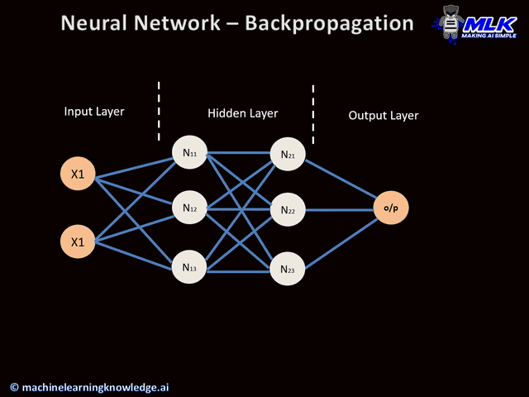
Visualising BPs
Notes:
This image illustrates backpropagation, a core mechanism in neural networks. Initially, data moves forward from the input layer, through the hidden layers, producing a prediction at the output layer. Then, backpropagation calculates the errors by comparing predictions with true values and propagates these errors backwards through the network, adjusting each neuron’s weights to minimise future errors. Think of this like receiving feedback on a presentation—each comment helps you understand where to improve, adjusting your approach to perform better next time.

Slide 13
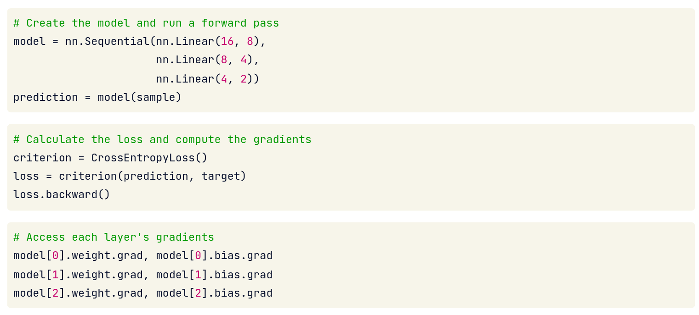
Backpropagation In PyTorch
Notes:
Luckily, PyTorch takes care of backpropagation directly. After running a forward pass on sample data, we define a loss function, here CrossEntropyLoss(), and use it to compare predictions with target values. We use .backward() to calculate gradients using this defined loss. This populates the .grad attributes of each layer's weights and biases. Each layer in the model can be indexed separately, beginning with a zero-index. Each layer has a weight, a bias, and the corresponding gradients.
Backpropagation in PyTorch (Autograd): Coding backpropagation by hand for a large network would be error-prone and tedious. Thankfully, modern libraries like PyTorch handle this automatically using a tool called autograd. In PyTorch, if you define a model and a loss, you can call .backward() on the loss tensor, and PyTorch will compute all the necessary gradients for you. The slides include a snippet that demonstrates this clearly. First, a simple model is created in PyTorch using nn.Sequential: for example, model = nn.Sequential(nn.Linear(16, 8), nn.Linear(8, 4), nn.Linear(4, 2)) to define a network with three linear layers (16 inputs, then hidden layer of size 8, another hidden of size 4, and finally 2 outputs) . Let’s say this model is meant to classify inputs into one of 2 classes. Next, a sample input is passed through the model: prediction = model(sample). This produces an output vector (prediction) of length 2 (scores for each class). Then a loss function is defined, e.g. criterion = CrossEntropyLoss(), and the loss is computed as loss = criterion(prediction, target) where target is the true class label for that sample (in the appropriate form) . At this point, we have a loss variable (a tensor) that depends on the model’s weights. Calling loss.backward() triggers PyTorch’s autograd: it will backpropagate through the network and calculate the gradient of the loss with respect to each weight and bias in the model . After this call, each parameter in the model (accessible via model.parameters() or individually like model[0].weight, model[0].bias, etc.) will have a .grad field containing the gradient. In the example from the slides, they show that after loss.backward(), one can inspect model[0].weight.grad, model[0].bias.grad, and similarly for layers 1 and 2, and see the gradient tensors for each . These gradients are exactly what we derived conceptually: they indicate how changing that parameter would change the loss.
Now that we understand conceptually what backpropagation does, let’s see it in action in PyTorch. One of the great features of modern libraries like PyTorch is that autograd (automatic differentiation) is built-in. This means PyTorch can automatically compute the gradients for us via backpropagation, as long as we set up our computations correctly.
The typical workflow in PyTorch is:
1. Forward pass: You take input data and run it through your model to get an output.
2. Compute loss: Compare the model’s output to the true target using a loss function, resulting in a loss value (a single scalar tensor).
3. Call backward: You then call loss.backward(). At this point, PyTorch performs backpropagation: it goes through the computation graph of the model (the sequence of operations that produced the loss) and computes the gradient of the loss with respect to each model parameter. Those gradient values are stored in the .grad attribute of each parameter tensor.
A couple of things to note:
• Before calling backward(), we typically zero out any existing gradients (e.g. optimizer.zero_grad() or model.zero_grad()). This ensures that gradients from previous iterations don’t accumulate and interfere. If it’s not shown on the slide, keep in mind it’s an important step in a training loop.
• PyTorch’s autograd is dynamic, which means it builds the graph on the fly as operations happen. You just have to ensure your model’s parameters have requires_grad=True (which is True by default for nn.Module parameters), and PyTorch will know to track operations on them.
The key takeaway: PyTorch automates backpropagation. We don’t have to manually derive and code the gradient for each parameter. We rely on the library to do it. This allows us to build complex networks without worrying about the math of each layer’s derivative every time – we can focus on designing the network and the training logic.

Slide 14
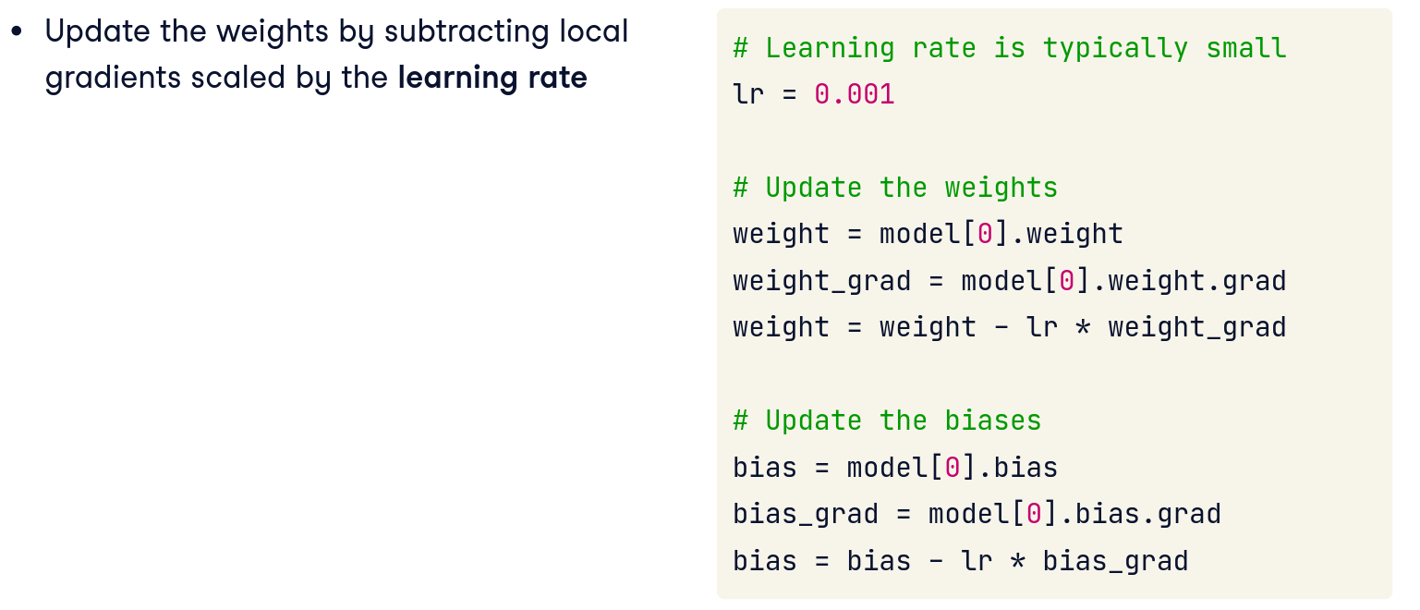
Updating Model Parameters
Notes:
To update model parameters manually, we access each layer gradient, multiply it by the learning rate, and then subtract this product from the weight. We'll learn more about the learning rate later, which is a tunable parameter used in training.
Updating Model Parameters – Gradient Descent: Now that we can compute gradients, the next step is to use those gradients to actually update the model’s parameters and hopefully achieve a lower loss on the next round. The simplest approach to do this is called gradient descent. The idea is straightforward: adjust each parameter in the direction that most reduces the loss. Mathematically, we take a step in the negative direction of the gradient.
Now that we’ve computed gradients via backpropagation, the next step is to update the model’s parameters (the weights and biases) so that the loss is hopefully a bit lower the next time around. This slide likely shows how that update is done, either conceptually or with code.
There are two primary ways to update parameters in practice:
• Manual gradient step: Using the gradient values, you subtract a fraction of the gradient from each weight. For example, if w is a weight and w.grad is its gradient, you do something like w = w - learning_rate * w.grad. The learning rate is a small factor (like 0.01) that controls how big a step to take. You would do this for every weight and bias in the model. In code, you might loop through model.parameters() and adjust them. Often we also wrap this in a torch.no_grad() block because we don’t want to track these adjustments in autograd.
• Using an optimizer object: PyTorch provides optimizer classes (like torch.optim.SGD, torch.optim.Adam, etc.) that handle the update step for you. You initialize an optimizer with the model’s parameters and a learning rate. Then each iteration, after calling loss.backward(), you simply call optimizer.step(), and it will perform the parameter updates internally. You also call optimizer.zero_grad() before the next iteration to reset gradients (to the point we mentioned earlier).
This code goes through each parameter tensor in the model, and subtracts the gradient scaled by the learning rate. The with torch.no_grad() is there to prevent PyTorch from trying to compute gradients for these operations – since we’re just updating values, not part of the model’s forward computation.
The important concept is: we adjust each model parameter in the direction that reduces the loss. This typically means subtracting the gradient (because gradient points uphill, negative gradient points downhill). The learning rate is crucial – it’s like the step size of our hill descent:
• If the learning rate is too high, we might step too far and miss the valley (even increase loss or diverge).
• If it’s too low, we’ll make very slow progress (like baby steps down the mountain).
In the context of our training loop, updating the parameters is the final piece of one iteration. After this update, the model’s weights are slightly different – ideally a bit more tuned to the data. Then we loop back (get the next batch of data, forward pass, etc.). Over many such iterations, the model will hopefully converge to a state of low loss (good performance).
So to wrap up: Backprop gave us the direction to move each weight, and updating the parameters actually moves them a bit in that direction. This is one step of the gradient descent algorithm (which we’ll formally talk about on the next slide). Perform thousands of these small steps, and the model will gradually learn to make better predictions.

Slide 15
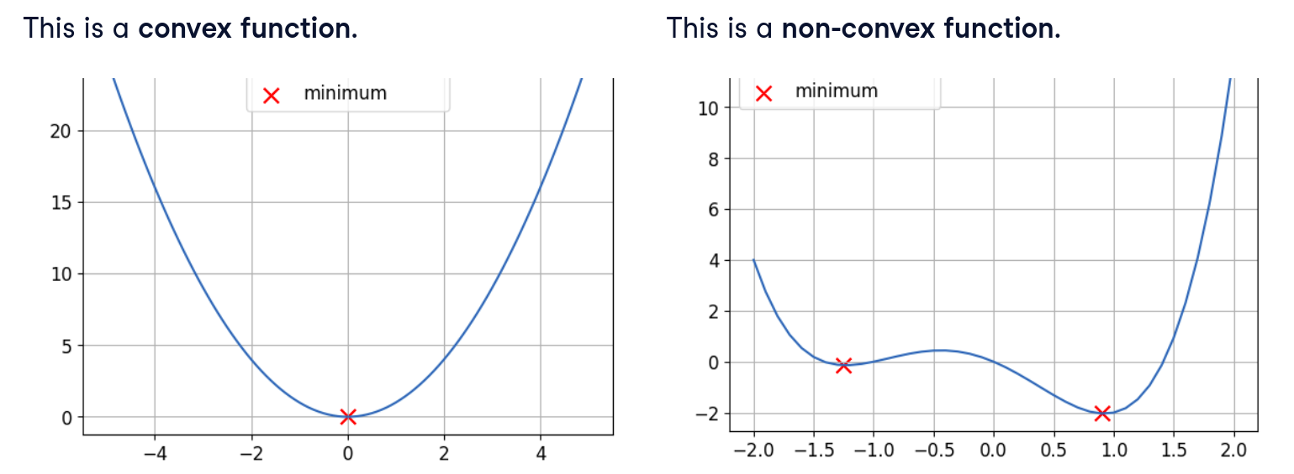
Convex and Non-convex Functions
Notes:
This slide introduces an important concept in optimization: convex vs. non-convex functions. It’s relevant because the loss surface of a neural network can be complicated, and understanding this helps us appreciate the challenges in training.
A convex function is one that curves outward like a bowl. Formally, any line drawn between two points on the curve lies above or on the curve. But intuitively: a convex loss landscape has a single valley (one global minimum). If you imagine a simple U-shaped curve (like a parabola), that’s convex – it has one lowest point, and no matter where you start, if you go downhill (using gradients) you’ll eventually reach that lowest point. Many classical machine learning problems have convex loss functions. For example, linear regression with mean squared error has a convex loss surface; logistic regression has a convex loss in parameter space. This is nice because it means gradient descent is guaranteed to find the global best solution (given enough time and a proper learning rate).
A non-convex function, on the other hand, can have a landscape with multiple hills and valleys (local minima and local maxima). Picture a mountain range or an egg carton shape – lots of peaks and dips. A function that’s non-convex might have many local minima (points where the function is lower than nearby points, but not the lowest overall). Neural network loss surfaces are non-convex. Because of the complex interactions of weights in layers, the error surface can be very wiggly with many local dips, flat plateaus, and saddle points.
Why does this matter for training?
• In a convex scenario, if we keep following the gradient downwards, we will reach the global minimum loss (the best possible). It’s a straightforward optimization story.
• In a non-convex scenario, gradient descent might lead us to a local minimum that isn’t the absolute lowest loss, depending on where we started and how the surface is shaped. We could get stuck in a valley that is not the very bottom of the whole landscape. Or we might encounter flat regions (where gradient ~0 but we haven’t reached a real minimum yet – a saddle point).
• However, in very high dimensions (like with lots of weights), it turns out many local minima might be quite good (close to the global minimum in loss value) and some may generalize just as well as the global min. So even if we don’t find the perfect global minimum, we can usually find a solution that’s good enough for our purposes.
The slide likely shows a simple 2D illustration: one convex curve (smooth U-shape) versus a non-convex curve (wiggly with multiple dips). The convex curve has one clear bottom; the non-convex has multiple potential “bottoms.”
For students, the takeaway is: training neural networks is a harder optimization problem than something like fitting a line, because of non-convexity. Gradient descent will still try to go downhill, but there’s no guarantee it finds the absolute best set of weights – and that’s okay. In practice we often get a “good enough” low loss which yields good performance.
This concept also motivates using techniques like:
• Random restarts or different initializations (you might get a different solution if you start the weights differently).
• Using momentum or advanced optimizers that might help escape shallow local minima or plateaus.
• But the good news: even a local minimum in a big neural net can often be quite good.
So, summarizing: Convex = one valley, easy to find true bottom. Non-convex = many valleys, we settle for a low one. Neural nets have non-convex loss surfaces, but in practice gradient methods still find pretty good solutions.

Slide 16
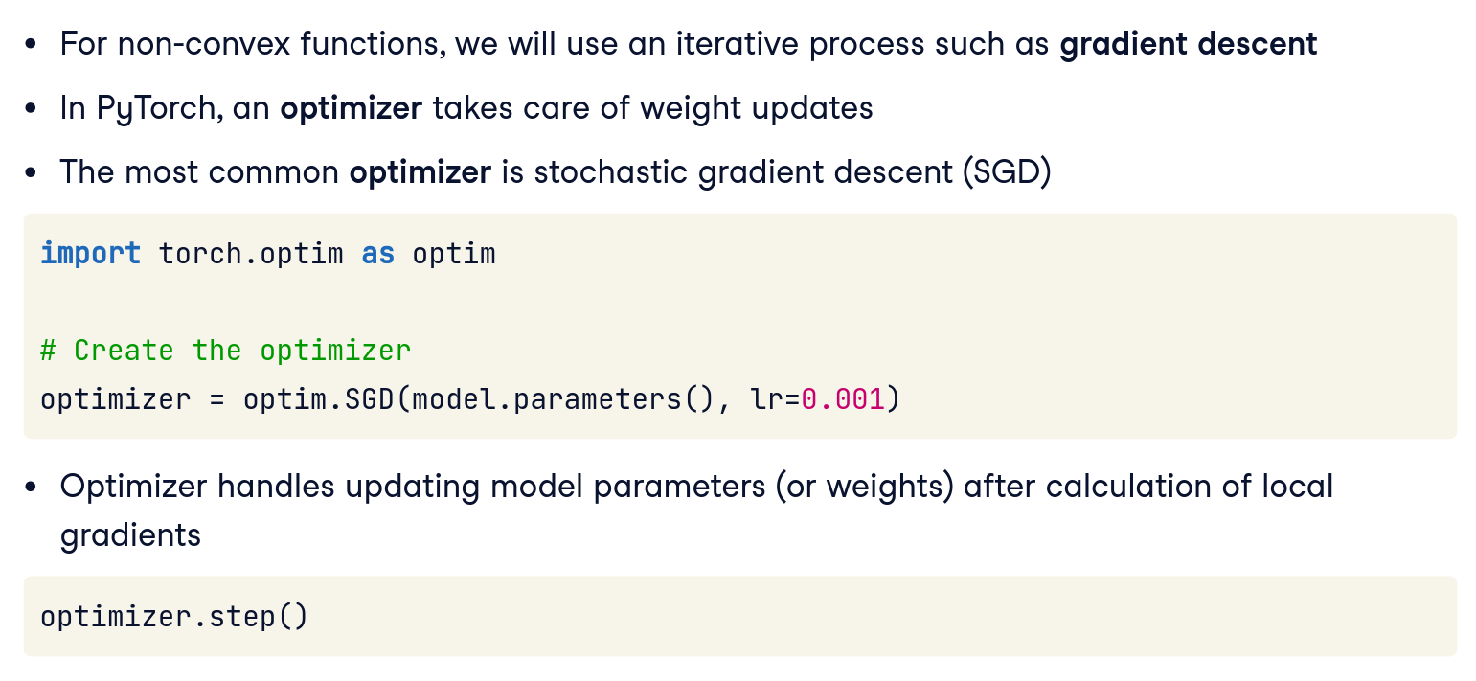
Gradient Descent
Notes:
Spoiler alert: loss functions used in deep learning are not convex! To find global minima of non-convex functions, we use a mechanism called "gradient descent". PyTorch does this for us using "optimizers". The most common optimizer is stochastic gradient descent (SGD). We use optim to instantiate SGD as shown. .parameters() returns an iterable of all model parameters, which we pass to the optimizer. We use a standard learning rate, "lr", here, but this is tunable. The optimizer calculates gradients for us, and updates model parameters automatically, by calling .step(). Magic!\
Here we focus explicitly on Gradient Descent, which is the fundamental optimization algorithm we’ve been implicitly discussing to adjust model parameters. Now we’ll formalize it a bit.
Gradient Descent is an iterative method to find a minimum of a function (here, our loss function). The basic update rule for gradient descent is:
\theta := \theta - \alpha \nabla_\theta L(\theta)
Where:
• \theta represents a parameter (or a vector of parameters).
• L(\theta) is the loss as a function of those parameters.
• \nabla_\theta L(\theta) is the gradient of the loss with respect to \theta.
• \alpha is the learning rate (a small positive number like 0.01) controlling the step size.
In plain English: adjust each parameter slightly in the direction that most reduces the loss. We subtract the gradient times the learning rate because the gradient points in the direction of increasing loss, so the opposite is the direction of decreasing loss (downhill).
Key points to mention:
Learning Rate (\alpha): It’s critical to gradient descent. Too high and you might overshoot the minimum or diverge (imagine taking huge leaps on the hill and jumping over the valley or going higher). Too low and you make snail’s progress and might get stuck in a local crevice or take forever.
Convergence: In nice convex problems, gradient descent converges to the minimum as long as \alpha is small enough. In non-convex problems, we typically run it for a certain number of iterations or until improvements are negligible. We might not find the perfect minimum, but we often find a good solution.
Stochastic Gradient Descent (SGD): Often, we don’t compute the gradient on the entire dataset at once (especially if dataset is huge). Instead, we compute it on one or a few training examples at a time (mini-batches). This introduces some noise – the gradient is a bit wrong relative to the total dataset – but it turns out to still work and is much faster per update. This is why you hear “SGD” so much. In practice, what we do in our loop with batches is stochastic/mini-batch gradient descent. It might jump around a bit due to sampling noise, but it generally goes downhill and it can even help escape local minima sometimes.
For students: Gradient descent is the core algorithm by which neural networks learn. Every training iteration, we’re performing a gradient descent step – computing the gradient and nudging weights accordingly. Over time, this finds parameters that (hopefully) minimize the loss function.
It’s a simple idea but, combined with backprop to efficiently get gradients, it’s what enables us to train large neural networks.
One more intuitive note: It’s like improving by trial and error – each time we adjust the model a bit to do better on the data, gradually honing in on a good setting.

Slide 17
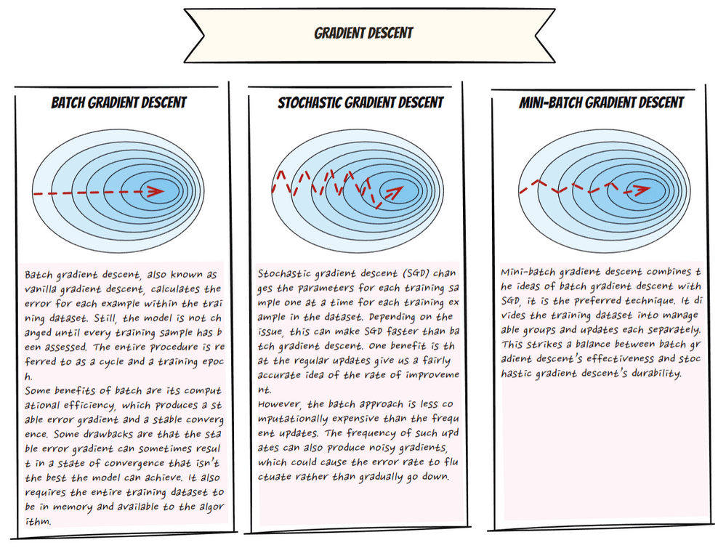
Different types of GDs
Notes:
This slide is about Gradient Descent, the fundamental algorithm for optimizing our model’s parameters. We’ve been alluding to it, and now we’ll describe it explicitly.
Batch Gradient Descent:
Calculates gradients using the entire dataset each iteration. Very stable convergence but computationally expensive and slow for large datasets.
Stochastic Gradient Descent:
Uses only one sample per iteration. Fast, noisy updates enable quick progress but can cause instability and fluctuations during training.
Mini-Batch Gradient Descent:
Balances the two by computing gradients on small batches of data. It provides smoother updates and good stability, making it the standard in practice.
Basic idea: We repeatedly take small steps in the direction that lowers the loss the fastest (i.e., the direction of the negative gradient). Over time, these steps should lead us to a minimum of the loss function.
Gradient Descent Algorithm (conceptually):
1. Initialize the weights with some values (often random).
2. Compute the loss on the training data.
3. Compute the gradient of the loss with respect to each weight (this is the backprop step giving us $\frac{\partial L}{\partial w}$ for each $w$).
4. Update each weight:
$$ w := w - \eta \frac{\partial L}{\partial w}, $$
where $\eta$ is the learning rate ￼. This means we subtract the gradient times a small factor from the current weight.
5. Repeat steps 2-4 for many iterations (processing either one training example at a time or a batch of examples at a time). Iterate until the loss is as low as we can get it or until we’ve done a predetermined number of steps/epochs.
Over iterations, the weights “descend” the loss curve. If you imagine a simple U-shaped curve (convex case), gradient descent will move the weight downhill step by step until it converges at the bottom. In a complex curve (non-convex), it will move down but might end up in some valley which might or might not be global minimum as discussed.
Stochastic Gradient Descent (SGD): Often you’ll hear this term. The difference from plain gradient descent is that instead of computing gradients on the entire dataset (which is gradient descent in batch form), we compute on a subset (like one training example or a mini-batch). This introduces some noise (hence “stochastic”), but it often helps navigate complex loss surfaces and is more efficient for large datasets. In practice, when we loop over training data and update weights incrementally, we are using SGD or mini-batch SGD.
Learning rate insight: Choosing the right $\eta$ is important. If the slide has a graphic, it might show:
• A too-large learning rate causing jumps that overshoot the minimum (maybe even diverging if it’s extremely large).
• A too-small learning rate leading to tiny, almost flat progress (it’ll reach the minimum but very slowly).
• Just right: a learning rate that makes steady progress downhill.
Often, we adjust the learning rate during training or do some trial and error to find a good value. Advanced optimizers adapt the effective step size for each parameter.
In summary, gradient descent is the workhorse of training: it’s an iterative method that uses gradients to tweak the model and minimize loss. It’s conceptually simple but powerful. Every time we talk about the model “learning,” it essentially comes down to applying gradient descent (or a variant) to adjust the weights.
Now that we’ve covered gradient descent in theory, let’s apply everything we’ve learned: we’ll walk through training a simple neural network step by step, summarizing the process.

Slide 18
Training a Neural Network
Create a model
Choose a loss function
Create a dataset
Define an optimizer
Run a training loop, where for each sample of the dataset, we repeat
Calculating loss (forward pass)
Calculating local gradients
Updating model parameters
Notes:
If we create a model, choose a loss function, create a dataset and define an optimizer, we are finally in a position to train a model. We can then loop over each element of the dataset, calculate the loss, compute local gradients and use them to update model parameters. This final step is repeated a certain number of times, and is called the training loop. In scikit-learn, the training loop is located in the .fit() method of the model. We'll have to implement our own training loop in PyTorch.
This slide lays out the overall workflow for training a neural network in a clear step-by-step format. It’s essentially a summary of Part 1 – combining everything we’ve discussed into a procedure. The steps are:
1. Create a model: Define your neural network architecture. Decide how many layers and neurons you need, and choose an activation function for the hidden layers (likely ReLU, which we’ll justify in Part 2). In code, this means writing a class or using nn.Sequential to set up layers. At this stage, the model’s weights are initialized (usually randomly).
2. Choose a loss function: Pick an appropriate loss for your task. For classification, as we saw, we use cross entropy. For a regression problem (predicting a continuous value), we might use Mean Squared Error. The loss function is our measure of “how wrong” the model is.
3. Create a dataset: Prepare the data we’ll train on. This includes gathering the data, splitting into training (and typically validation/test sets), and perhaps normalizing or encoding features as needed. In PyTorch, you might use a Dataset class and a DataLoader to handle batching conveniently.
4. Define an optimizer: Choose the optimization algorithm (and hyperparameters like learning rate). For instance, decide between simple SGD or a more advanced optimizer like Adam, and set the learning rate (and maybe momentum, etc.). In code, you’d do something like optimizer = torch.optim.SGD(model.parameters(), lr=0.01) or torch.optim.Adam(...).
5. Run a training loop: Now iterate through your training data for multiple epochs. In each iteration (typically each batch or each epoch):
• (a) Calculate loss (forward pass): Feed a batch of input data through the model to get outputs (predictions), then compute the loss by comparing these outputs to the true targets.
• (b) Calculate local gradients (backward pass): Perform backpropagation (loss.backward()) to compute gradients of the loss w.rt. all the model’s parameters.
• (c) Update model parameters: Use the optimizer to adjust the weights by a small amount in the direction of lower loss (optimizer.step()). Then reset gradients (optimizer.zero_grad()) before the next iteration.
And we repeat step 5 for many epochs until the model converges (or we hit some stopping criterion).
This list encapsulates all the key ingredients:
• You need a model (architecture + initial weights).
• You need a way to measure error (loss).
• You need data to learn from.
• You need an optimization strategy to update weights.
• And then you loop, looping being the actual learning process.
I’d relate it to what we did with the salary example:
1. We decided a simple neural network structure.
2. Chose MSE as loss.
3. Had our salary dataset ready.
4. Used SGD or Adam as optimizer.
5. Ran loops of forward pass, backward, update.
For the audience, seeing it enumerated helps solidify the training procedure and shows that each step has a purpose.

Slide 19
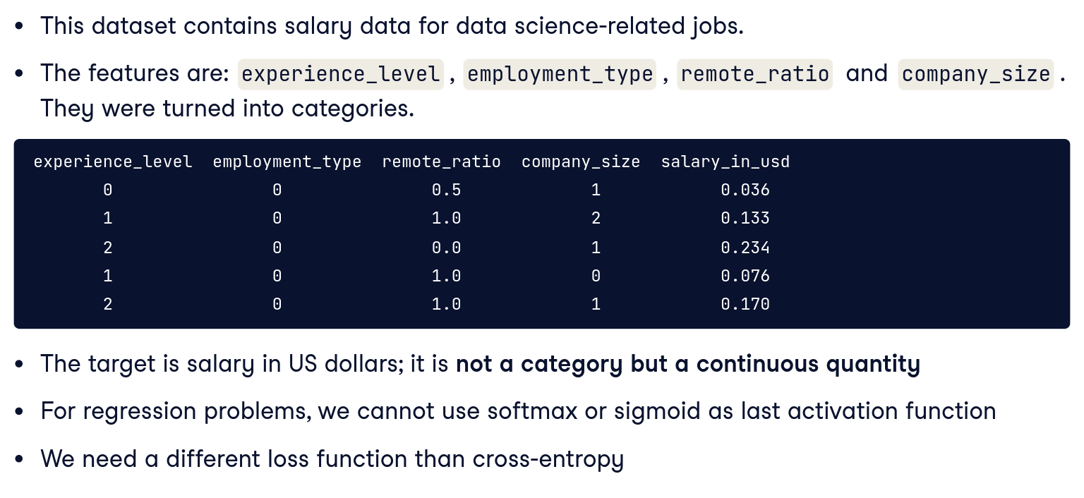
Data Science Salary Dataset
Notes:
We'll use a new dataset containing salaries of data scientists. The features have been turned into categories and the target is salary in US dollars. The data has been normalized. The target is not a category but a continuous quantity, making this a regression problem. Recall that we can use mostly the same neural network structure for regression and classification problems, but need to make a few adjustments. First, we cannot use a softmax or sigmoid activation for the last activation function as they are only used in classification problems. Our last layer will be a linear layer. Second, we need a new loss function, because cross entropy loss is also solely used for classification problems.
Next, we introduce a concrete example dataset to apply these training concepts: the Data Science Salary Dataset. This dataset likely contains information about data science (or related) job roles and their salaries, along with various features per job.
For example, the dataset might include columns like:
• Job Title/Position: e.g., Data Scientist, Data Analyst, Machine Learning Engineer, etc.
• Experience Level: perhaps a number of years or categorical levels (Junior, Mid, Senior).
• Location: maybe country or region (since salaries differ by region).
• Industry or Company Size: possibly something about the workplace.
• Salary: the actual salary (probably normalized or annual salary in USD, etc., as the target to predict).
Our goal with this dataset is likely to predict the salary based on the other features. That’s a regression task (since salary is numeric).
This dataset makes the training process real: we can design a network to take in features like title, experience, etc., and output a predicted salary. Then we can train it on this data (which ties back to step 3 in the previous slide – we have our dataset).
On the slide, there might be a brief description or snippet, e.g.:
• “Dataset contains records of data science professionals with various attributes (role, experience, location, etc.) and their salaries. We’ll use a neural network to predict salary from these features.”
It’s relatable because many people wonder how those factors affect salary, and it demonstrates a practical use of regression with neural nets.
We’ll use this dataset in a few ways:
• In Part 1, maybe we refer to it when talking about MSE loss (since that’s suitable for salary prediction).
• In Part 3, we’ll likely use it to demonstrate trying more layers to improve accuracy, and maybe cleaning text data (the optional task might involve job title text).
• Possibly Part 2 doesn’t directly reference it, since activation discussion is general.
So at this point, I’d explain what features we might have and how we’ll encode them:
• For example, “experience years” as a number (maybe normalized).
• “Job title” might be categorical text. We can convert that into features via one-hot encoding or similar (each unique title becomes a binary feature, or we group them into categories).
• “Location” similarly could be one-hot for regions.
• These go into the input layer neurons.
• The network then has some hidden layer(s) and outputs a single number (predicted salary).
• We’ll train it with MSE loss (which we talked about).
• Use an optimizer like Adam perhaps.
By introducing the dataset here, we set context that we’ll be using it as a running example for experiments (like adding layers, etc.).
The slide might not go into all these details (some may have been given in a previous day or an assignment), but I ensure the audience knows what our case study is.
Now, since this is a regression, the next slide appropriately is about MSE Loss, which we’ll use for training this salary model.

Slide 20
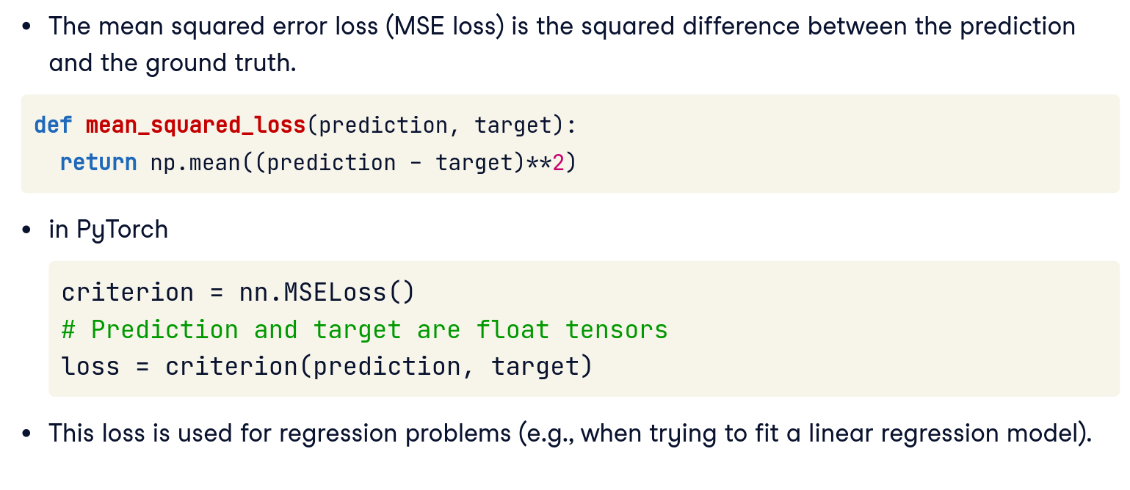
Mean Squared Error Loss
Notes:
We can use mean squared error (MSE) loss for regression problems. It is used in scikit-learn when calling the .fit method on a linear regression model. The MSE loss is the mean of the squared difference between predictions and ground truth, as shown in this Python implementation. The nn.MSELoss function is also available in PyTorch and can be used as a criterion similarly to cross entropy loss, where prediction and targets must be a float tensor.
Mean Squared Error (MSE) Loss: For regression tasks, where the goal is to predict a continuous value (like a salary or a price), we typically use mean squared error. MSE is the average of the squares of the differences between predicted values and actual values . For example, if the true salary is $100k and the model predicts $90k, the squared error for that instance is $(100 - 90)^2 = 100$. We average such squared errors over all training examples to get the MSE. Formally, \text{MSE} = \frac{1}{m}\sum_{i=1}^{m} (\hat{y}^{(i)} - y^{(i)})^2, where $\hat{y}^{(i)}$ is the prediction and $y^{(i)}$ the true value . Squaring emphasizes larger errors (so big mistakes are penalized more than small mistakes), and the averaging makes it an overall measure of model performance on the dataset. Like cross-entropy, MSE is differentiable, which means we can compute gradients from it. Minimizing MSE corresponds to making predictions as close as possible to the actual values. If the model predicts perfectly for all training examples, the MSE would be 0 (no error). In PyTorch, you might use torch.nn.MSELoss or simply compute (predictions - targets).pow(2).mean() as the loss. MSE loss results in a nice convex shape for simple linear models, which helps optimization (more on convexity soon), but it may not be appropriate for probabilities or classification tasks – that’s why we don’t use MSE for classification, and instead prefer cross-entropy in those cases.
Squaring the error means that larger errors contribute disproportionately more to the loss than smaller errors (e.g., being $10k off leads to 100 million in squared error units vs $1k off is 1 million). This heavily penalizes big mistakes, which can be useful to drive the model to avoid those.
Why use MSE here instead of cross entropy? Because cross entropy is for comparing probability distributions (class predictions vs true class), whereas here we have a continuous value. MSE directly measures how far off we are in salary terms. If the model predicted $90k for an actual $100k, the squared error is (100-90)^2 = 100 (in units of thousands squared, if we treat those as raw numbers), whereas if it predicted $110k, squared error is also (110-100)^2 = 100. So both are equally bad in squared error terms, which makes sense as both are $10k off.
A note: sometimes for regression people use Mean Absolute Error (MAE) as well, which is |y - ŷ| averaged. MAE is less sensitive to outliers (no square). MSE, by squaring, places extra emphasis on cases where the model is very wrong – which can be good if those outliers matter a lot, but can also make the model skewed or training tougher if those outliers dominate. But MSE is the more common choice, and it leads to nice calculus (gives linear derivatives).
So, summarizing to the audience: Mean Squared Error is our loss function for the salary predictor model. It calculates how far off the predictions are from the true salaries on average. Our training goal will be to minimize this MSE, meaning we want the predictions to be as close as possible to the actual salaries.
We’ll observe the MSE go down as the model learns (on training data), and ideally the validation MSE will go down too, indicating the model is learning useful patterns rather than just memorizing.

Slide 21
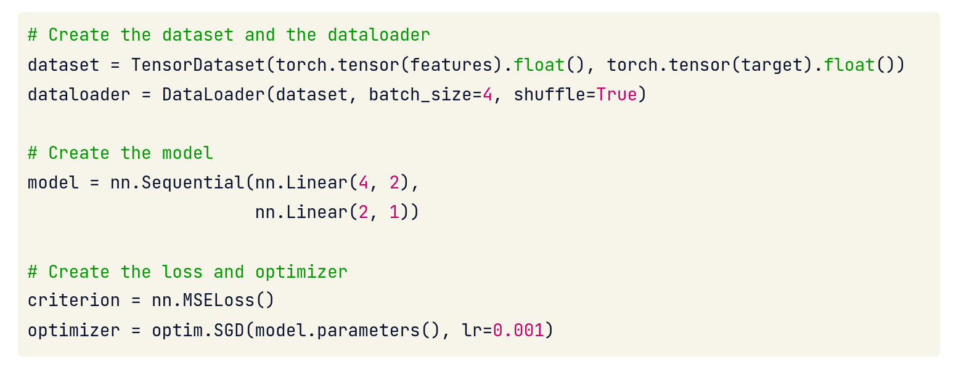
Before Training Loop
Notes:
Let's put everything together now. We have two NumPy arrays, "features" and "target", containing our data and labels. We start by passing these to a class called "TensorDataset". TensorDataset() has extensive functionality we'll encounter later, but here we use it to organize our features and targets into the right data types, floats. This casting is required, and float is the data type used by the parameters of our model. We can now load our dataset into a different class: DataLoader(). DataLoader() enables us to create "batches" of data, that are passed through the model in each forward/backward pass. Here we use a small batch size of four, but selection of batch size is customizable depending on the use case. We create our model next. This dataset has four input features and one target (output). Because this is a regression problem, we do not need one-hot encoding and the final linear layer outputs a single float. Finally, we create the mean square loss criterion and the optimizer. A ten to minus three learning rate is a good default learning rate for most deep learning problems.

Slide 22
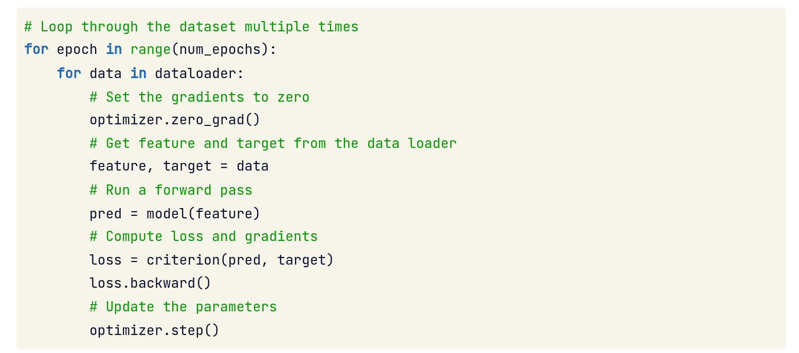
Training Loop
Notes:
We can now loop through the dataset multiple times. Looping through the entire dataset once is called an epoch and we train over multiple epochs, indicated by num_epochs. For each epoch, we loop through the dataloader. Each iteration of the dataloader provides a batch of samples, which we saw earlier. Before the forward pass, we set the gradients to zero using optimizer.zero_grad(), because the optimizer stores gradients from previous steps by default. We get features and targets from each sample of the dataloader. We use the features for the forward pass of the model, and we use the target for the loss calculation. Finally, we use the optimizer to update the parameters of the model.
This slide likely describes the setup we need to do before we start iterating in the training loop for our salary model example (or any model). It’s basically summarizing that steps 1-4 from slide 13 have been done, and we’re ready for step 5 (the loop).
What should be in place:
Model defined: For example, we might have a neural network with, say, an input layer matching our feature count, one hidden layer of some neurons (or more), and an output layer of 1 neuron for salary. Suppose we made a simple one-hidden-layer network initially.
Loss function chosen: We decided on criterion = nn.MSELoss().
Data prepared: We have our train_loader that provides batches of features (like experience, job title encoded, etc.) and targets (salaries). Perhaps we also have a val_loader for validation data.
Optimizer ready: e.g., optimizer = torch.optim.SGD(model.parameters(), lr=0.01) or maybe Adam (since Adam often works well without much tuning). The optimizer knows which parameters to update.

Slide 23
Part 2
Notes:
Assignment

Slide 24
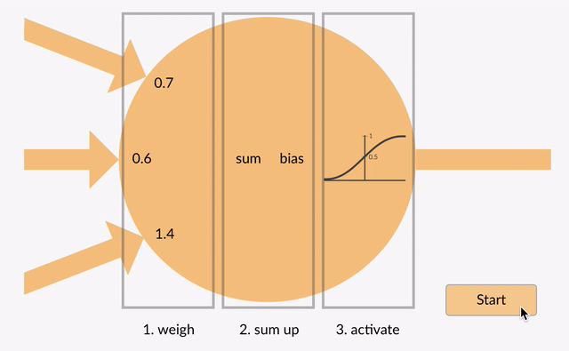
Recall AFs
Notes:
These images illustrate the concept of activation functions in neural networks. Activation functions are mathematical operations that decide if a neuron should activate (“fire”) or stay inactive. The first image illustrates a sigmoid activation function, which takes input values, applies weights, sums them up, adds a bias, and squashes the result into a range between 0 and 1. This mimics decision-making—similar to deciding whether to open an email: if the weighted signals (e.g., sender trust, urgency, relevance) surpass a certain threshold, the email is opened.
The second image shows a tanh activation function, which similarly combines weighted inputs but outputs values between -1 and 1, useful for tasks requiring outputs centred around zero. For instance, consider sentiment analysis on reviews: tanh can classify statements as negative (-1), neutral (0), or positive (+1), effectively capturing the nuanced sentiment range.

Slide 25
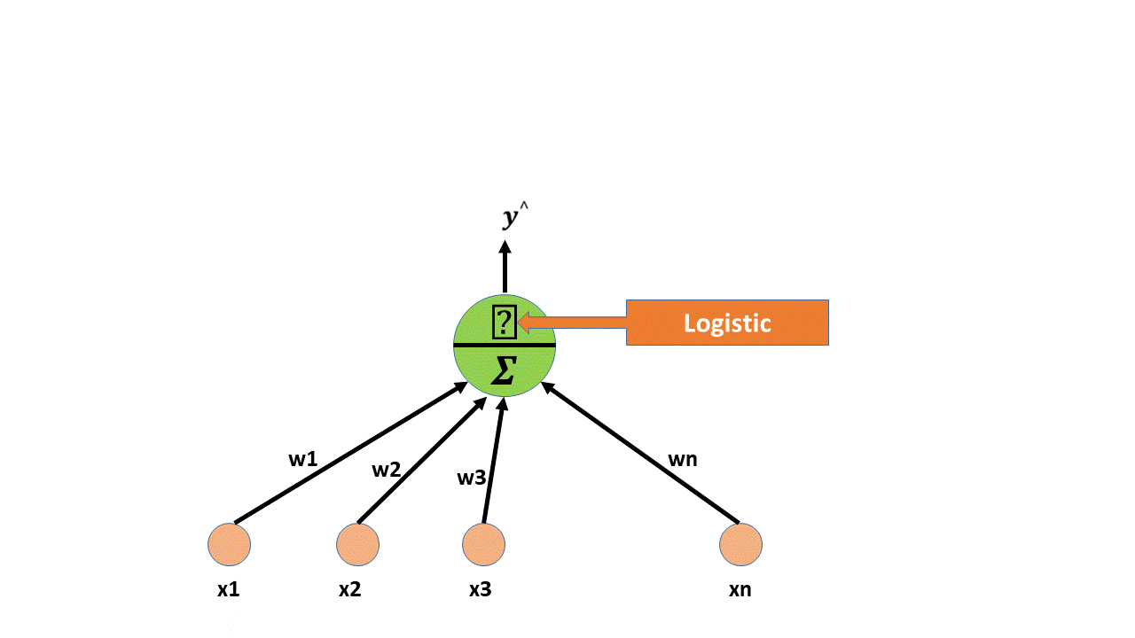
Recall Afs 2
Notes:
These images illustrate the concept of activation functions in neural networks. Activation functions are mathematical operations that decide if a neuron should activate (“fire”) or stay inactive. The first image illustrates a sigmoid activation function, which takes input values, applies weights, sums them up, adds a bias, and squashes the result into a range between 0 and 1. This mimics decision-making—similar to deciding whether to open an email: if the weighted signals (e.g., sender trust, urgency, relevance) surpass a certain threshold, the email is opened.
The second image shows a tanh activation function, which similarly combines weighted inputs but outputs values between -1 and 1, useful for tasks requiring outputs centred around zero. For instance, consider sentiment analysis on reviews: tanh can classify statements as negative (-1), neutral (0), or positive (+1), effectively capturing the nuanced sentiment range.

Slide 26
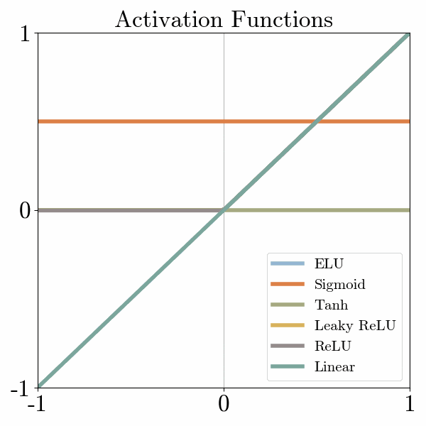
Recall AFs 3

Slide 27
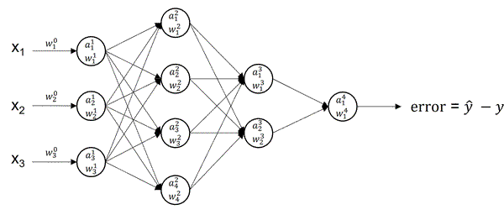
Recall AFs 4

Slide 28
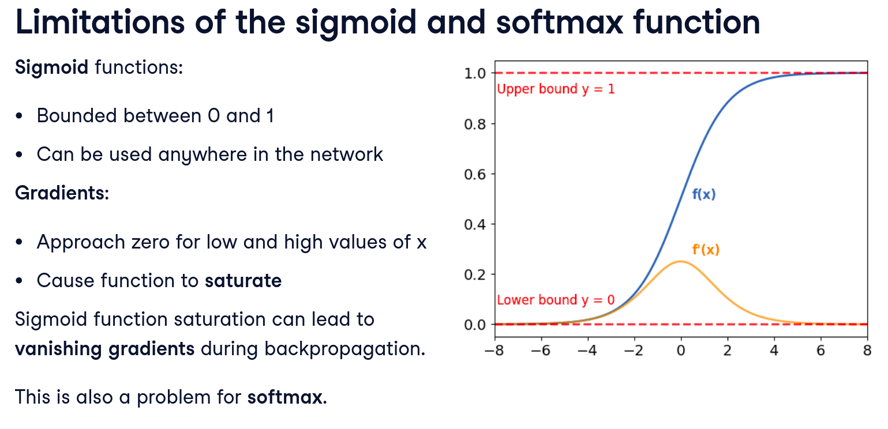
Limitations of Sigmoid and Softmax Function
Notes:
We'll begin by understanding some of the limitations of the sigmoid function. Recall that the outputs of the sigmoid are bounded between zero and one, meaning that for any input, the output will be greater than zero and less than one. Unlike the softmax function, it can be used anywhere in the network. When we plot out the derivatives (or gradients) of the sigmoid function in orange, we find that the gradients are always low and approach zero for low and high values of x. This behavior is called saturation. This property of the sigmoid function creates a challenge during backpropagation because each local gradient is a function of the previous gradient. For high and low values of x, the gradient will be so small that it can prevent the weight from changing or updating. This phenomenon is called vanishing gradients and makes training the network challenging. Because each element of the output vector of a softmax activation function is also bounded between zero and one, the softmax also saturates.
In early neural networks (and even now for certain network parts), the sigmoid function was commonly used as an activation, and the softmax function is (and was) used at output layers for multi-class classification. However, using sigmoid (or softmax) in hidden layers of deep networks presents some significant problems.
First, recall these functions:
• Sigmoid takes any input x and squashes it to a value between 0 and 1: \sigma(x) = \frac{1}{1 + e^{-x}}. It produces an S-shaped curve: \sigma(0)=0.5, \sigma(x) approaches 1 as x \to +\infty, and approaches 0 as x \to -\infty.
• Softmax takes a vector of values and turns it into a probability distribution that sums to 1. For an input vector z, \text{softmax}(z)_i = \frac{e^{z_i}}{\sum_j e^{z_j}}. Typically used in the output layer for multi-class classification (e.g., if you have 3 classes, softmax gives you 3 probabilities summing to 1).
Limitations of using these in hidden layers:
1. Vanishing Gradients with Sigmoid: Sigmoid saturates at the high and low ends. When the input to a sigmoid neuron is very large positive, the output is near 1 and the gradient (derivative) is near 0. Likewise, if input is very large negative, output ~0 and gradient ~0. Only in the middle range (around input 0) does sigmoid have a sizable gradient. In a deep network with many layers of sigmoids, what often happens is the outputs of neurons tend to be in the saturated extremes (especially if weights aren’t tiny), so the gradients through those neurons become very small. As you backpropagate from the output towards the input, these small gradients multiply together (chain rule). If each layer gives a factor < 1, by the time you reach early layers, the gradient is practically zero. This is known as the vanishing gradient problem. It means the early (lower) layers in the network learn incredibly slowly because the feedback (gradient) they get is minuscule. Historically, this made training deep networks with many sigmoid layers extremely difficult – essentially, deeper than 2-3 hidden layers and the network would hardly improve because the lower layers never got meaningful gradient signal.
2. Non-zero-centered Output (Sigmoid): Sigmoid outputs are between 0 and 1, always positive. This means that the activations in hidden layers are not zero-centered; a typical sigmoid neuron might output, say, 0.7 on average (depending on biases). Why is this an issue? Because if, for example, all outputs of a layer are positive, then the gradients for the weights in the previous layer (which depend on those outputs) will be either all positive or all negative (before considering the error term). This can lead to inefficient zig-zagging updates of weights. Ideally, we want some outputs to be positive, some negative, so that weight updates can go in either direction more naturally. This isn’t as severe a problem as vanishing gradients, but it does slow convergence. (For comparison, the tanh function outputs between -1 and 1, so it’s zero-centered; tanh was often preferred over sigmoid for hidden layers for this reason, but tanh still has the saturation issue causing vanishing gradients.)
3. Softmax in Hidden Layers – Not Used: We typically do not use softmax for hidden layers at all; it’s almost exclusively for output layer to produce probabilities. If one tried to use softmax in a hidden layer (which would force that layer’s outputs to sum to 1 and be positive), you’d have a similar issue: many outputs would be near 0 except one near 1 (especially if one component of the input is larger), causing most gradients to be tiny. Also, it’s a constraint the network doesn’t need in hidden layers – there’s no reason hidden neurons’ outputs must form a probability distribution. So, we keep softmax for the end. The limitation to mention: softmax, like sigmoid, can saturate; e.g., if one class logit is much higher than others, the softmax output for that class ~1 and others ~0, and the gradient for those near-0 outputs is very small. But again, this is mainly relevant at the output, and we can manage that.
4. Computational Expense: Sigmoid (and softmax) involve exponentials. This is usually fine, but it’s a bit more work than simpler operations like addition and comparison. In a huge network, avoiding unnecessary exponentials can save time. More importantly, exponentials can cause numerical issues if the input is very large or very small (overflow/underflow), whereas simpler functions like ReLU don’t have that problem.
The bottom line is: When you stack many layers with sigmoid activations, the learning tends to stall because the gradients become extremely small in earlier layers (vanishing gradient). This was observed in the ’90s and 2000s – people had trouble training neural nets with, say, 5 or 10 hidden layers using sigmoids or tanh; they just didn’t improve much after a certain point.
For example, if each sigmoid layer on average multiplies gradient by, say, 0.2 (just an illustrative number from its slope), after 5 layers the gradient is 0.2^5 = 0.00032 of what it was – essentially vanished.
So, we needed a different activation that doesn’t cause such heavy gradient decay. That leads us to ReLU, which addresses these issues.

Slide 29
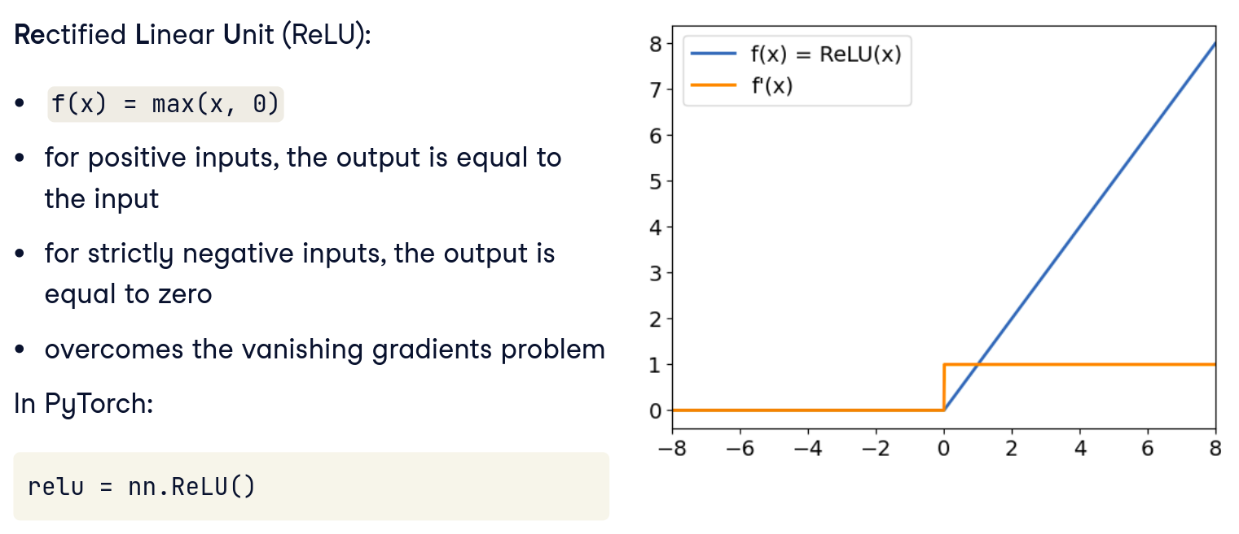
ReLU Function
Notes:
Let's discover a new activation function, the rectified linear unit or ReLU. The ReLU function outputs the maximum between its input and zero, as shown by the graph. For positive inputs, the output of the function is equal to the input. For strictly negative outputs, the output of the function is equal to zero. This function does not have an upper bound and the gradients do not converge to zero for high values of x, which overcomes the vanishing gradients problem. In PyTorch, the ReLU function may be called using the nn module as shown. ReLU is a good default choice of activation for many deep learning problems.
Enter ReLU (Rectified Linear Unit) – a game-changing activation function for deep networks. ReLU is very simple:
Now, why is ReLU awesome for deep nets?
Non-linearity: First, ReLU is indeed non-linear (because of that corner at 0). It may look piecewise linear, but that’s fine – the key is it’s not a pure linear function overall, so stacking ReLUs can produce non-linear effects. So it keeps the ability of networks to learn complex mappings (a network of only linear activations would collapse into an equivalent single-layer linear model, which is not what we want).
No saturation for positive inputs: For x>0, ReLU’s derivative is 1. That means if a neuron’s output is, say, 10, the gradient through that neuron (if it’s in the positive region) is not small – it’s full strength (multiplied by 1). It does not shrink the gradient at all on the positive side. Compare that to sigmoid, where an output of 0.999 has a tiny gradient. With ReLU, large outputs don’t kill the gradient. So deep networks can sustain gradients through many layers if those neurons are active (output > 0). This largely solves the vanishing gradient problem within the active regions of the network.
Sparsity (outputs can be zero): For x<0, ReLU outputs 0. This means neurons can effectively turn off. In a given layer, some neurons will output 0 (if they get negative summed input) and others will output some positive value. This makes the network’s representations sparse – which can be beneficial. Only a subset of neurons are active for any given input. Sparse representations are easier to compute with (multiplying by 0 is cheap) and can help reduce interferences between features (one neuron being off means it’s not contributing to errors or interactions). Also, conceptually, it’s nice that a neuron can “specialize” – it either fires (for relevant patterns) or stays silent for others.
Efficiency: Computing ReLU is very fast – just a comparison and possibly setting to zero. No exponentials, no divisions. This makes your network run faster. Also, the gradient is super simple (1 or 0 depending on the sign of input).
Better gradient flow: In backprop, when a ReLU is active (input > 0), it passes the gradient back unchanged (multiplied by 1). When it’s inactive (input < 0), it passes no gradient back (multiplied by 0). So for an active path through a deep network (neurons all active), the gradient doesn’t diminish through those layers at all! It can still diminish due to other factors (like weight initialization scale, etc.), but not because of the activation function. For paths that go through an inactive neuron, gradient stops – which might sound bad, but actually those are the paths where that neuron wasn’t contributing anyway. It does mean a ReLU neuron that’s off will not learn from that particular example (because gradient is blocked). But it can still learn from other examples where it’s on.

Slide 30
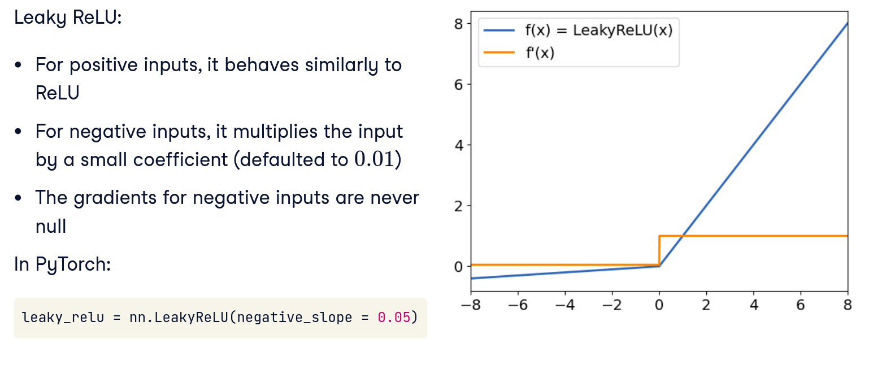
Leaky ReLU
Notes:
The leaky ReLU is a variation of the ReLU function. For positive inputs, it behaves similarly to the ReLU function. For negative inputs, however, it multiplies them by a small coefficient (defaulted to zero.zero-one in PyTorch). By doing this, the leaky ReLU function has non-null gradients for negative inputs. In PyTorch, the leaky ReLU function is called using the nn module as well. The negative_slope parameter indicates the coefficient by which negative inputs are multiplied.
As mentioned, a potential problem with standard ReLU is that if a neuron’s input is always negative, it outputs 0 always and doesn’t get gradient to change that – it can “die.” Leaky ReLU is a small tweak to ReLU to prevent completely zero gradients for negative inputs.
Benefits of Leaky ReLU:
Prevents full death: Because even if a neuron is in the “off” regime for inputs, it still outputs a small value and thus has a non-zero gradient (\alpha) passing back. This means its weights can still get adjusted a bit, potentially moving it out of the off region for some future inputs. So a neuron won’t completely get stuck; it can recover if circumstances change.
Keeps good stuff: It’s still mostly like ReLU for positive (so retains that advantage), and if \alpha is small, for negative it’s almost flat but not quite. This minimal leakage typically doesn’t hurt performance and might help with stability.

Slide 31
Why Do We Use ReLU?
Simplicity
Non-linearity
Sparsity
Avoiding vanishing gradient
Empirical success
Notes:
Rectified Linear Unit (ReLU) is one of the most commonly used activation functions in neural networks, and there are several reasons for its popularity:
Simplicity: ReLU is a simple function defined as 40 f(x) = \max(0, x) 41. It is computationally efficient to compute and does not involve complex mathematical operations like sigmoid or tanh functions.
Non-linearity: ReLU introduces non-linearity to the network, allowing it to learn complex patterns and relationships in the data. This is crucial for the network to approximate non-linear functions effectively.
Sparsity: ReLU leads to sparse representations in the network, where many of the neurons output zero. Sparse representations can speed up training and reduce the likelihood of overfitting by introducing regularization effects.
Avoiding vanishing gradient: Unlike sigmoid and tanh functions that saturate in the extreme regions of their input space, ReLU does not saturate in the positive region. This helps in mitigating the vanishing gradient problem during backpropagation, enabling faster convergence and better learning in deep neural networks.
Empirical success: ReLU has been empirically shown to perform well in a wide range of deep learning tasks, leading to its widespread adoption in various architectures like CNNs (Convolutional Neural Networks) and ANNs (Artificial Neural Networks).
Efficient training: ReLU can accelerate the convergence of stochastic gradient descent (SGD) compared to saturating activation functions like sigmoid and tanh. This is because ReLU allows the gradient to flow more easily during backpropagation.
Initialization: ReLU activation functions work well with certain weight initialization techniques like He initialization, which helps in training deep networks more effectively.
Despite its advantages, ReLU is not without its limitations. One common issue is the "dying ReLU" problem, where neurons can become inactive and output zero for all inputs during training. This can hinder learning in certain cases, leading to the development of variants like Leaky ReLU, Parametric ReLU, and Exponential Linear Units (ELUs) to address this issue.
In summary, ReLU is popular in neural networks due to its simplicity, non-linearity, sparsity-inducing properties, avoidance of vanishing gradient issues, empirical success, efficient training characteristics, and compatibility with certain initialization methods.

Slide 32
Part 3
Notes:
Assignment

Slide 33
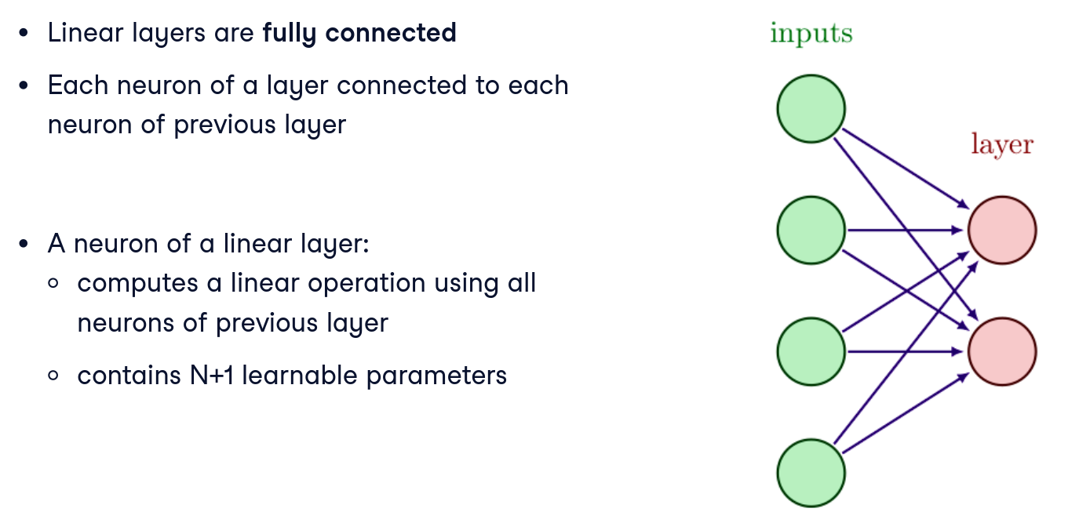
Layers and Neurons
Notes:
This slide likely revisits the structure of a neural network: input layer, hidden layers, and output layer, as well as what we mean by “neurons” in each layer.
Input Layer: This is the set of input nodes that simply take in the feature values. They are not doing any computation (no weights on these connections as part of a previous layer – though sometimes we conceptualize them as having weights from a “bias” or environment, but effectively, input layer is just the data). If your data has d features, the input layer has d nodes. For example, in the salary dataset, if we have features like [years experience, job title (encoded), location (encoded), etc.], the input layer has one node per feature dimension after encoding.
Hidden Layers: These are the layers between input and output that do computations. Each hidden layer consists of a number of neurons (units). Each neuron in a hidden layer takes inputs from all neurons in the previous layer (whether that’s the input layer or a previous hidden layer), computes a weighted sum of those inputs (plus a bias), and then applies an activation function (like ReLU). The outputs of all neurons in a hidden layer become the inputs to the next layer. Hidden layers are where the network “builds up” intermediate representations or features. The number of hidden layers is the depth of the network (e.g., 2 hidden layers = a 2-layer hidden network, sometimes called a 3-layer network if counting input as layer 1 and output as last).
Output Layer: The final layer produces the outputs of the network – the predictions. The number of neurons in the output layer is determined by the task:
For regression predicting one number (like salary), you have 1 output neuron (and no activation or a linear activation, since you want an unbounded number typically).
For binary classification, you might also have 1 output neuron (with a sigmoid giving probability of class 1) or 2 output neurons (with softmax giving probabilities for class0 vs class1).
For multi-class classification (say 5 classes), you have 5 output neurons with a softmax.
The output neurons take inputs from the last hidden layer and apply typically an appropriate activation (linear, sigmoid, softmax, etc., depending on task).
Neurons: When we say “number of neurons” in a layer, we mean how many units are computing an activation in that layer. For hidden layers, that’s a design choice/hyperparameter. More neurons = potentially more capacity to model complex functions (because the layer can capture more features), but also means more weights (so more data or regularization may be needed to avoid overfitting, and more computational cost).
So, a network architecture can be summarized by listing how many neurons per layer. E.g., “5-10-1 network” might mean 5 inputs, 10 hidden neurons, 1 output. Or “5-10-10-1” means input layer of size 5, first hidden layer 10 neurons, second hidden layer 10 neurons, output layer 1 neuron.
Counting layers: Important note – when we refer to a “3-layer network” in older literature, it often meant 3 layers including input and output (so 1 hidden). To avoid confusion, we usually just specify hidden layers explicitly: e.g., “two hidden layers” instead of “4-layer network” (which could be interpreted differently). We’ll clarify this again soon in slide 27.
Now that we know what layers and neurons are, the next question is: what if we change the architecture by adding more layers? That’s what we’ll examine next.

Slide 34
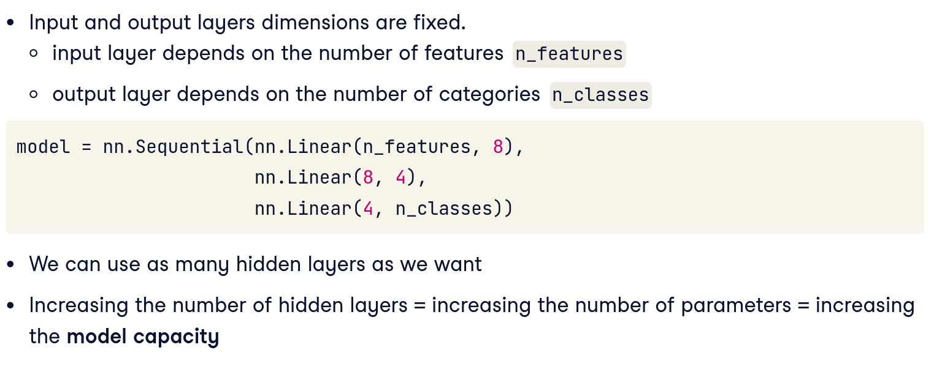
Tweaking Number of Hidden Layers
Notes:
When designing a neural network, the dimensions of the input layer (the first layer) and output layer (the last layer) are fixed for us. The number of neurons in the input layer is the number of features in our dataset, and the number of neurons in the output layer is the number of classes we want to predict. In the code shown, n-underscore-features and n-underscore-classes are imposed by our dataset. However, we can add as many hidden layers as we want, as long as the input dimension of a layer matches the output dimension of the previous one. For example, this model has two hidden layers. When we increase the number of hidden layers, we effectively increase the number of parameters in the model. We also call this increasing model capacity. Models with more capacity can work with more complex datasets.
On this slide, we introduce the idea of experimenting with model depth – specifically, increasing the number of hidden layers – and seeing how it affects performance.
Suppose we start with a fairly simple network for our task (say the salary prediction or any classification we might have on hand):
Perhaps initially we use one hidden layer (because that’s the simplest non-trivial network – sometimes called a “shallow” network).
Now, we consider adding an extra hidden layer (making it a “deeper” network).
What does adding a layer do conceptually? It allows the network to model more complex relationships. A single hidden layer network can approximate many functions (universal approximation theorem), but it might need a very large number of neurons to do so for complicated functions. Two smaller layers might factor the problem into stages – learning intermediate features in the first layer, then combining them in the second layer – which can be more parameter-efficient and capture hierarchical structure in data (common in images, language, etc.). Essentially, depth can exponentially increase the function complexity you can represent with a manageable number of neurons.
Concretely, if our original model (Model A) had architecture, say:
Input layer (features) -> [Hidden layer with H neurons] -> Output layer.
Our new model (Model B) could be:
Input -> [Hidden layer1 with H1 neurons] -> [Hidden layer2 with H2 neurons] -> Output.
For a fair comparison in an experiment, we might keep total number of parameters somewhat similar (e.g., if we add a layer, maybe each hidden layer has fewer neurons so that overall parameters count is similar). Or we might just allow more parameters and see if the validation performance justifies it.
This slide likely sets up that we’re going to compare one hidden layer vs two hidden layers. Perhaps the slide suggests something like:
“Experiment: Increase the number of hidden layers from 1 to 2 and observe validation accuracy.”
We want students to think about:
Will a deeper model train to lower training loss (i.e., fit data better)? Probably yes or at least not worse, since it has more freedom (more parameters).
More importantly, what happens to validation accuracy? Does it go up (meaning the model was underfitting with one layer and needed more depth to capture the pattern)? Or does it stay same or even go down (maybe overfitting or the problem didn’t need extra complexity)?
There’s no one-size-fits-all: sometimes extra layers help if the problem has complex structure to learn; sometimes they don’t help if one layer was enough or if you don’t have enough data to utilize the extra capacity.
I might mention an intuition: A classic example – if your data requires learning an XOR-like pattern or something non-linearly separable, one hidden layer with enough neurons can do it, but two layers might do it with fewer neurons because the first layer can learn some boolean features and second layer combines them. In deep learning for images, one hidden layer would have to directly map pixels to categories in one jump – which is hard. Two layers can first detect edges, then shapes from edges, then classify – adding layers builds hierarchical features (this is very evident in ConvNets, but in fully connected it’s less obvious features but similar concept holds).
Anyway, this slide sets the stage for the results which come next.
Perhaps it also alludes to adjusting hyperparameters for fair comparison, but that might be in the narrative: e.g., ensure to train both models sufficiently (maybe adjust epochs if needed).

Slide 35
Tweaking Number of Hidden Layers
Notes:
When designing a neural network, the dimensions of the input layer (the first layer) and output layer (the last layer) are fixed for us. The number of neurons in the input layer is the number of features in our dataset, and the number of neurons in the output layer is the number of classes we want to predict. In the code shown, n-underscore-features and n-underscore-classes are imposed by our dataset. However, we can add as many hidden layers as we want, as long as the input dimension of a layer matches the output dimension of the previous one. For example, this model has two hidden layers. When we increase the number of hidden layers, we effectively increase the number of parameters in the model. We also call this increasing model capacity. Models with more capacity can work with more complex datasets.

Slide 36
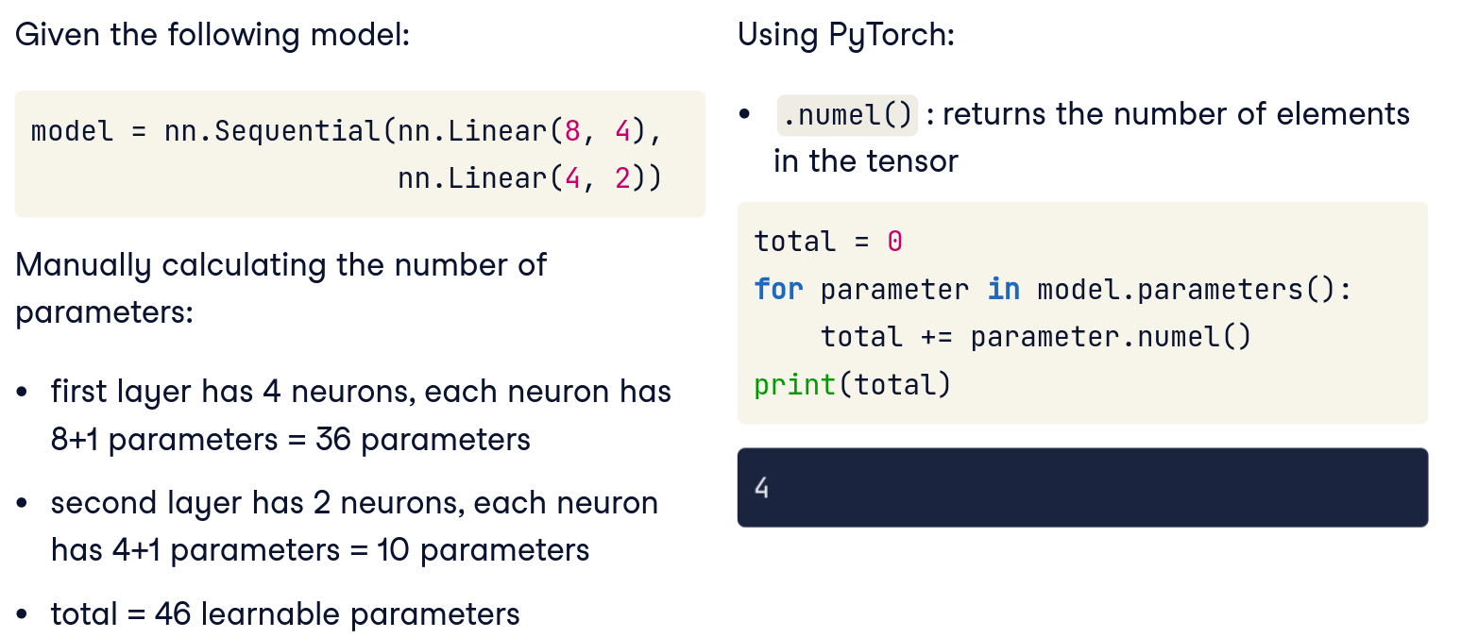
Counting Number of Hidden Layers
Notes:
A good metric to assess the capacity of our model is the total number of parameters. Let's consider this model made of two layers. We can manually count the parameters: the first layer has four neurons, and each of them has nine learnable parameters so it contains 36 parameters. The second layer has two neurons, each of them having five learnable parameters. In total, this model has 46 learnable parameters. We can do the same calculation in PyTorch using the .numel method of tensors, which returns the number of elements in the tensor. By looping over the model parameters, we can add the number of elements per parameter to the total variable, and verify that it also adds up to 46.

Slide 37
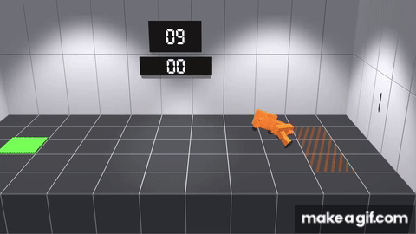
RNNs – Learning From Itself
Notes:
https://www.youtube.com/watch?v=L_4BPjLBF4E&t=373s
Recurrent Neural Networks (RNNs) are a powerful type of artificial neural network designed specifically for sequential data, capable of capturing and remembering information across multiple time steps, much like how a human brain retains context. Imagine teaching a robot, let’s call him Albert, how to walk. Each step Albert takes isn’t isolated but depends on the previous ones. Similarly, an RNN processes data step-by-step, taking information from the past (previous steps) to inform the present and future. As Albert tries to walk, each successful or unsuccessful step provides feedback that adjusts future actions—just as an RNN uses errors from predictions to refine subsequent outputs through backpropagation through time. This continuous feedback loop enables Albert to eventually learn to balance, adjust speed, and walk smoothly. Likewise, an RNN refines its internal weights, progressively learning the patterns and dependencies in sequences, enabling tasks like speech recognition, language modelling, and even predicting future events based on past experiences. Just as Albert progressively masters walking by retaining insights from his previous attempts, an RNN masters complex sequential tasks by learning and adapting from historical context.

Slide 38
Today’s Task
Play around with model complexity as in adding more hidden layers and see how validation accuracy is affected
(optional) use better techniques for cleaning text data to try to improve accuracy
Notes:
This slide outlines the assignments or exercises the students should undertake after the lecture to solidify their understanding. It has two main points:
1. “Play around with model complexity as in adding more hidden layers and see how validation accuracy is affected.”
This means the student should take a model (likely one they have built in a lab or assignment, perhaps from Day 7 or earlier in Day 8 if there was a coding part) and experiment with adding layers to it. For example, if they have a neural net solving some problem with 1 hidden layer, they should try training one with 2 hidden layers (and maybe even 3) and observe:
• Does validation accuracy improve? By how much?
• Does training accuracy improve much as well (and is there a gap opening between train and val indicating overfitting)?
• How does training time change (a deeper network might take more epochs or more time per epoch to train)?
• Essentially get a feel for the capacity vs performance relationship.
They should document or note the results. For instance, “I had a model with 1 hidden layer achieving 80% val accuracy, and with 2 hidden layers it went to 88% val accuracy. Training accuracy also went up from 85% to 95%, indicating the deeper model fit training data better and also generalized better in this case (underfit was reduced).” Or maybe they see no improvement or slight drop on val (maybe overfit) – either outcome is a learning experience.
The key is they get hands-on intuition: oh, adding depth can help, but it’s not guaranteed, and it depends on having enough data etc.
2. “(optional) use better techniques for cleaning text data to try to improve accuracy.”
This suggests that their dataset or one of the tasks involves text features (maybe the job titles in the salary data, or a separate text classification task). This reminds them that improving data preprocessing can boost model performance, sometimes more than tweaking the model.
Techniques for cleaning text data could include:
• Converting text to consistent case (lowercasing everything).
• Removing punctuation, special characters, or stop words.
• Perhaps stemming or lemmatization (reducing words to their root form).
• Removing or standardizing rare symbols, spacing issues, etc.
• If they used a simple encoding (like one-hot for words), maybe try a more sophisticated encoding (like bag-of-words or TF-IDF or word embeddings if that’s within scope).
• Possibly dealing with things like “Data Scientist” vs “DataScientist” (no space) anomalies if any – basically cleaning up messy data entries.
• In the salary dataset context, maybe normalizing job titles (e.g., mapping “Sr.” to “Senior”, etc., so that similar titles are recognized as same).
• Or maybe optional task is more open, like if they did a project on NLP classification, try improving the input text processing to see if accuracy improves.
This optional task underscores a key lesson: sometimes the easiest way to improve accuracy is not a fancier model, but cleaner or more informative data. Real-world data is often noisy, especially text. By cleaning it, you reduce variance and make patterns clearer, so the model can learn better with the same capacity.
Students who attempt this can compare accuracy before vs after cleaning to quantify the gain from better preprocessing.
In summary, the tasks are:
• Experiment with model depth and observe effects (practical demonstration of theory in Part 3).
• (Optional) Experiment with data cleaning to see its effect (which ties into an overall message: data quality matters as much as model architecture).
I’d encourage them to document their process:
“As you try additional layers, keep track of how both training and validation metrics change. That will help you understand if you’re addressing underfitting (both go down, val maybe goes down until a point), or causing overfitting (train goes way down, val worsens). Similarly, note any improvement from text cleaning, which could be quite significant if the text was noisy.”
This sets them up to apply what they learned in a hands-on way.
Finally, we have the last slide to conclude.

Slide 39
Thank You!!!
Notes:
Assignment

